Slide 1


SharePoint
CONTRIBUTORS AND USERS

Slide 2

SharePoint Online
General Introduction
SharePoint Online is a collaborative platform integrated into the Office 365 portal.
It allows you to create dynamic sites dedicated to a team, a project, a division or a department.
Authorized users can store, share, and organize work documents with their colleagues or external partners.
SharePoint Online is hosted on the Microsoft cloud and does not require any physical servers or internal resources.
It works with other Microsoft products and can be used with an Office 365 or Microsoft 365 license.
Notes:
SharePoint Online est une plateforme en ligne qui facilite la collaboration entre les membres d'une équipe. Il est intégré au Portail Office 365 et permet de créer des sites dynamiques pour stocker, partager et organiser des documents de travail. Grâce à son hébergement sur le Cloud Microsoft, SharePoint Online ne nécessite aucun serveur physique ni ressource interne et peut être utilisé via un simple navigateur web. Il est compatible avec d'autres produits Microsoft et peut être utilisé avec une licence Office 365 ou Microsoft 365.

Slide 3

The main functional areas of SharePoint
Team collaboration and productivity.
Enterprise content management.
Workflow and interoperability with business applications.
Access to knowledge: search for content and people.
Enterprise Social Networks: Profiles and Data Tagging.
Notes:
SharePoint propose une multitude de fonctionnalités pour répondre aux besoins des entreprises. Les domaines fonctionnels majeurs comprennent la collaboration et la productivité d'équipe, la gestion de contenu, les flux de travail, l'interopérabilité avec les applications de gestion, l'accès aux connaissances, les réseaux sociaux d'entreprise et le décisionnel.

Slide 4

SharePoint Online
Why choose SharePoint for your business
SharePoint can meet the company's collaboration needs, regardless of physical distance or workflows
SharePoint can improve the quality and consistency of information publishing across the enterprise
By enabling enterprise-wide skills capitalization, SharePoint prevents the loss of know-how and knowledge bases
Notes:
Les entreprises sont souvent confrontées à des problèmes de collaboration, que ce soit en raison de la distance physique ou des flux de travail. SharePoint peut aider à résoudre ces problèmes en améliorant la qualité et la régularité de la publication d'informations et en permettant la capitalisation des compétences à l'échelle de l'entreprise. Si votre entreprise rencontre des problèmes de communication, de circulation de l'information ou de perte de savoir-faire, SharePoint est une solution vivement recommandée.

Slide 5
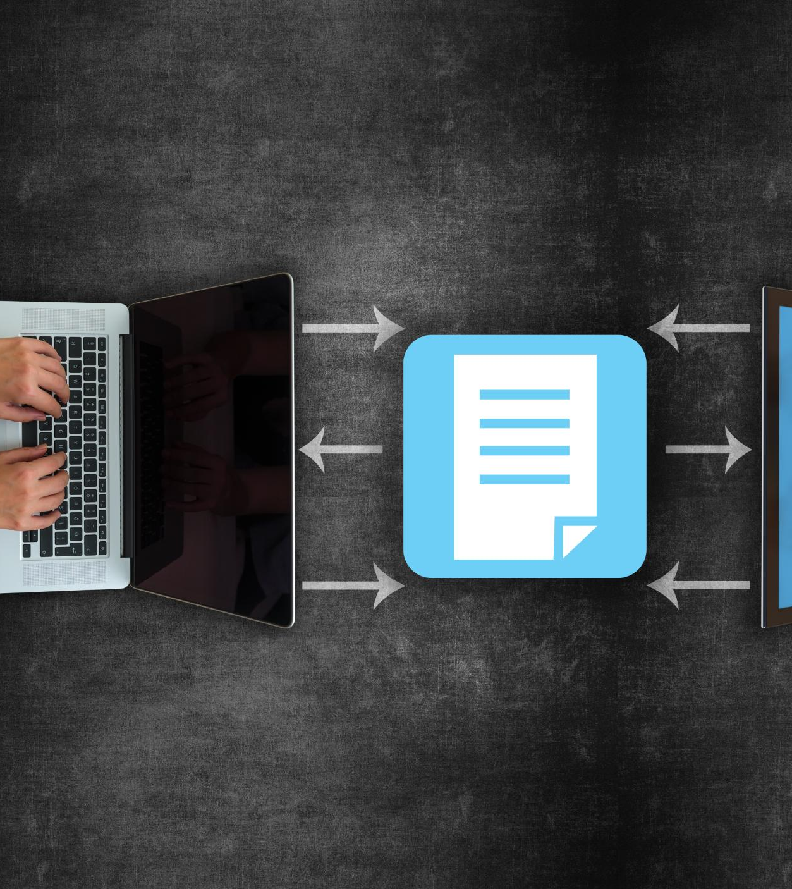
Use SharePoint to create an intranet
An intranet is a private website that is reserved for users of a private organization.
The intranet brings together contributors in the company.
SharePoint offers "social networking" features and content storage spaces dedicated to users.
Notes:
Un intranet est une application qui permet aux utilisateurs d'une organisation privée de partager des informations et de collaborer. SharePoint offre une solution d'intranet qui permet de fédérer les contributeurs dans l'entreprise grâce à des fonctionnalités avancées telles que des espaces de stockage de contenu dédiés aux utilisateurs et des fonctionnalités de type "réseaux sociaux". Grâce à sa disponibilité en mode SaaS, SharePoint Online permet également de partager du contenu avec des utilisateurs externes.

Slide 6

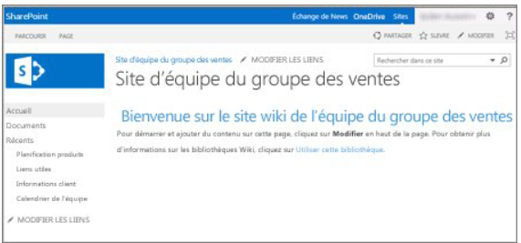
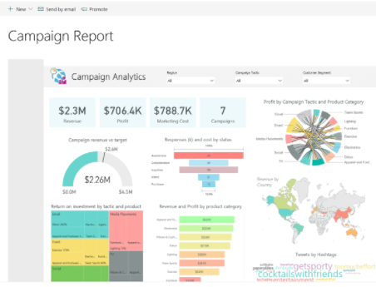
Use SharePoint to create an intranet
A SharePoint solution has many advantages, including:
Document management options via libraries (metadata and document type management)
Wiki page libraries allow you to quickly and unstructured gather business data in an easily editable format.
The development of solutions or apps allows the company to commission management solutions in record time (Power Apps)
6

Slide 7
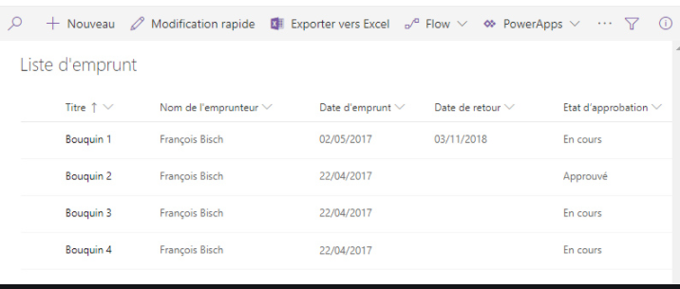
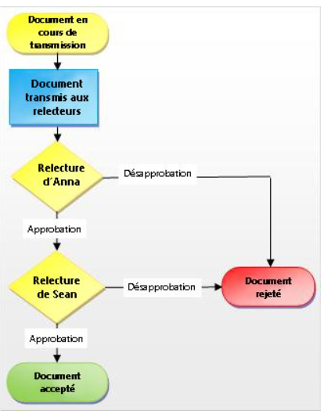
Use SharePoint to create an intranet
The advanced integration of Microsoft Office software makes it possible to make collaboration between people in the company a reality on a daily basis
Pre-existing SharePoint lists make it possible to manage team schedules, create sites with very targeted use, surveys, small project management, etc.
It is possible to integrate workflows to follow the company's processes in the circulation and processing of information (Power Automate)
7

Slide 8
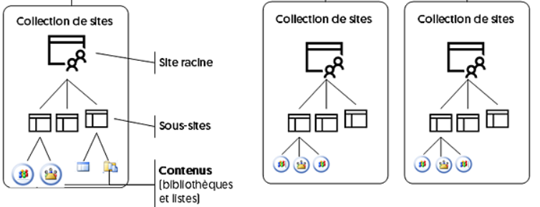
Architecture in SharePoint
Site collections
The site collection represents the content (data) of a SharePoint portal. A site collection contains a root site and subsites from the same path called management paths. The diagram below summarizes this architecture.
Each site collection contains a root site and, if necessary, one or more subsites, again for the purpose of classifying the information published and exchanged. Each site contains a set of pages and applications in the SharePoint language, which are in fact libraries (of documents, images), lists, or applications available on the SharePoint Store.
Why create multiple site collections?
For example:
Organizational reasons: Each department of the company uses information that other departments should not have access to or should be managed by different administrators.
Navigation or content types should be siloed.
8

Slide 9
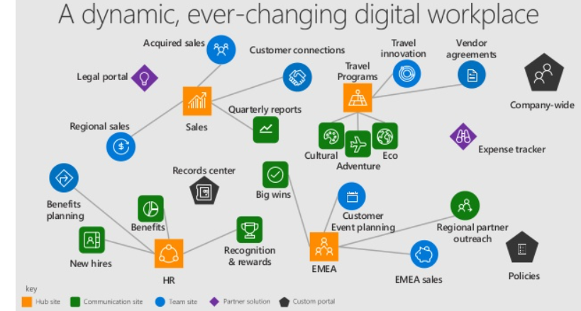
Architecture in SharePoint
The Hubs
SharePoint hub sites help you meet your organization's needs by connecting and organizing site collections based on project, department, region, and more.
This makes it possible to:
Discover related content such as news and other site activity
Enforce a common navigation and look and feel to all associated sites
Search all related sites
Some examples:
It is possible to bring together all our SharePoint project sites under a Project Hub.
It is possible to bring together all our department SharePoint sites under a Department Hub.
For an SME, you can consider a single company hub (acting as the company's home page) allowing access to the company's different departments and projects.
Advantages of the Hub:
Common navigation across all Hub sites
Unified search across all Hub sites
Change the appearance of all your sites in 1 click (cogwheel)
Consult the events and news of all the Hub's sites from your home page
9

Slide 10
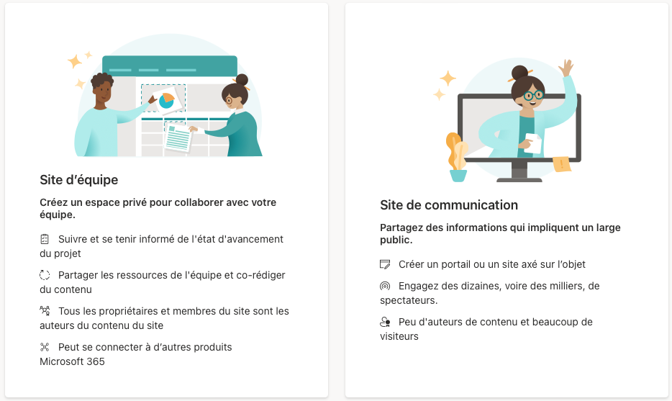
Create a SharePoint site
Team site or communication site?
You can use a team site to collaborate with your team members or even external ones. With a team site, all (or most) members can usually contribute to the site's content.
If you are simply looking to disseminate information to a wide audience, it is recommended that you use a communication site. In this case, only a small group of members can usually contribute content that is used by a much larger audience.

Slide 11

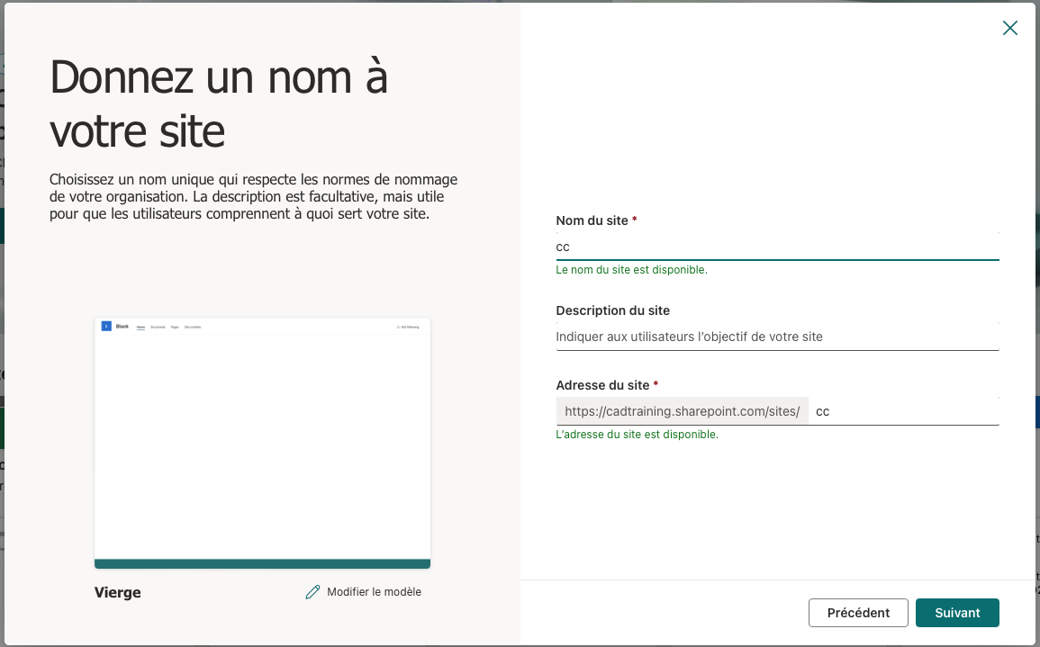
Create a SharePoint site
From your SharePoint home page, click Create site
Choose the type of site: Team or Communication.
Fill in the required fields
If the site is public, be careful. This means that all employees of the company can access this site without prior approval. In addition, they will have a publisher's right, which means that they can potentially remove its content. It's not very secure.
For all your sites, with some exceptions, choose a private group. Only invited people will be able to see the content and as a member they will not be able to administer the site (delete content...)

Slide 12
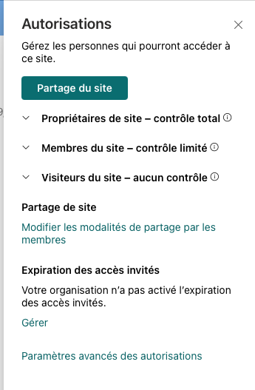
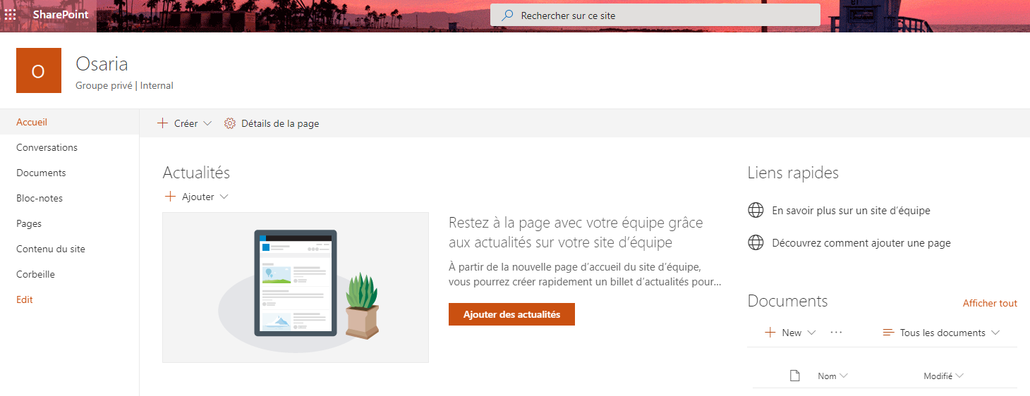
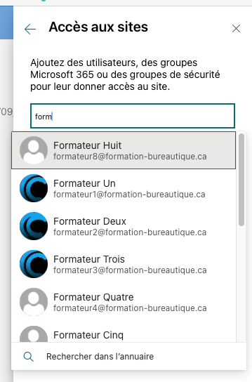
Create a SharePoint site
You can now or later add more owners and members.
Then validate the creation, your SharePoint site is ready!

Slide 13
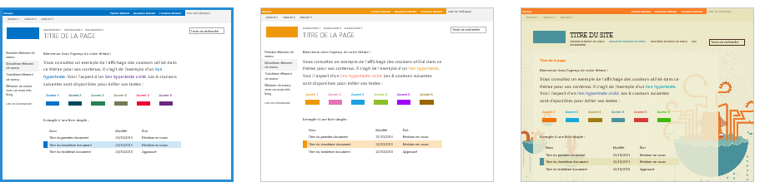
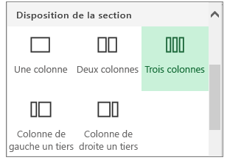
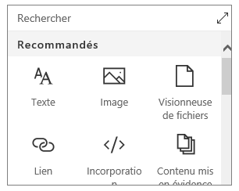
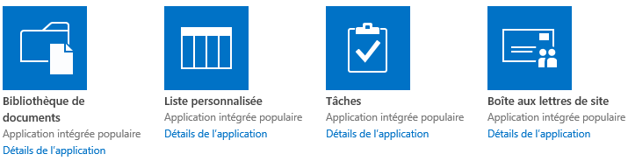
Customize a SharePoint site
Choose a theme and change the look and feel
Create, edit, and customize sections and pages of your site using rich, dynamic layouts.
Add Web Parts
Add and customize content: Libraries, lists, tasks, discussion forum...

Slide 14
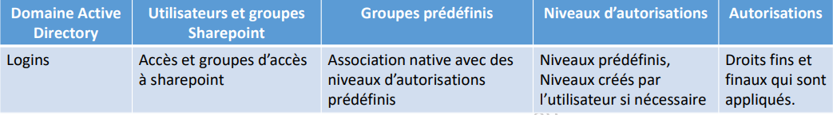
Access management in SharePoint
Manage permissions
Create permission groups
Customize permission levels
Security is applied hierarchically and by inheritance
It is possible to break this inheritance at the level of a site, a list or a library to give specific access
Membres
Visiteurs
Propriétaires
Accès total
Collaboration
Lecture seule
Site parent
Sous-site
Sous-site
Bibliothèque
Dossier
Élément
Sous-dossier
Élément
Élément
Liste

Slide 15
Access management in SharePoint Online
You can share your site or content from your site with anyone!
Internal
External
Sharing options:
Everyone grants access to the people who receive the link, whether they receive it directly from you or it was forwarded by a third party.
People who already have access can be used by people who already have access to the document or folder. Use this option if you just want to send a link to someone who already has access.
Specific People grants access only to the people you specify, if the link is forwarded, only people who already have access to the item will be able to use the link.
By default, Allow Editing is enabled. If you want users to only be able to view your files, uncheck the box.
Site parent
Sous-site
Sous-site
Bibliothèque
Dossier
Élément
Sous-dossier
Élément
Élément
Liste
You choose what you want to share:
The entire site
A library or a list
A dossier
A file

Slide 16
Access management in SharePoint Online
Share access to your SharePoint site
From the cogwheel under Site permissions, you will find the Invite contacts button
If you choose Add members to this group, the guest will have access to all the resources in the Office 365 group (SP site, Teams team...)
If you only want to give access to the SP site, choose Share this site only.
There are 3 default groups (visitors, members, and owners) but it is possible to create new ones with specific permission levels in Advanced Permissions Settings.
Choose the permission level you give your guest, then click Add.

Slide 17
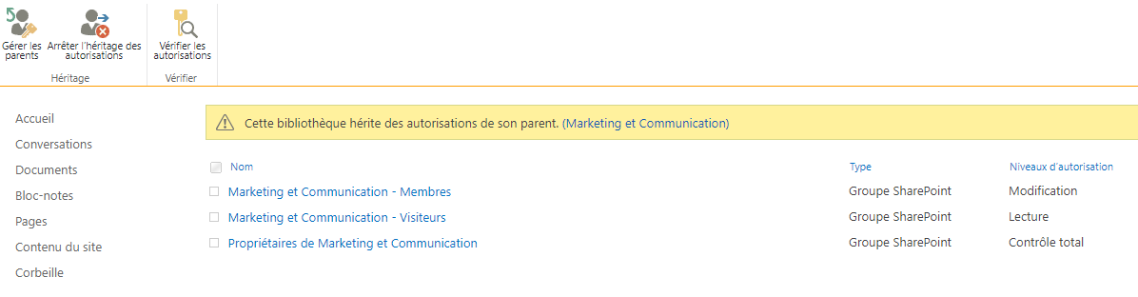
Access management in SharePoint Online
Share access to an SP library or list
We do not wish to share the entire SP site but only to provide access to the document library of our site.
Go to the library or targeted list.
Click the cogwheel and then click Library Settings
Select Permissions for Component: Document Library
You will arrive on the following screen:

Slide 18
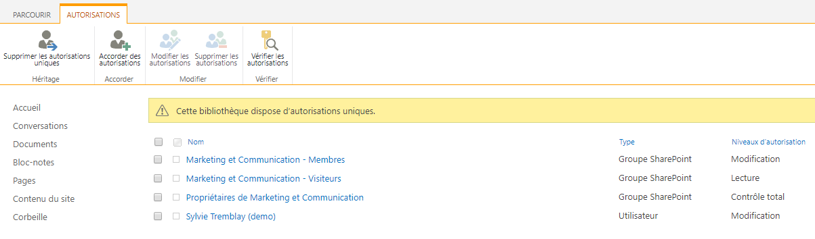
Access management in SharePoint Online
Click Stop Inheritance of Permissions to create unique permissions.
Now you see a ribbon that says: This library has unique permissions.
You can now add the members who need access to this library but not to the SP site as a whole by clicking Grant Permissions.

Slide 19
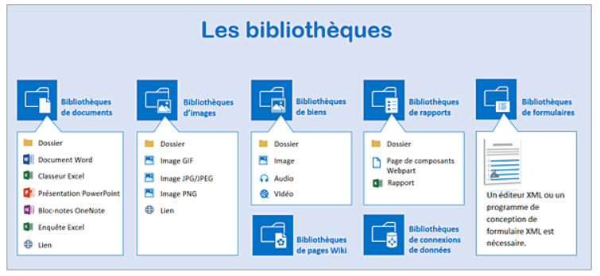
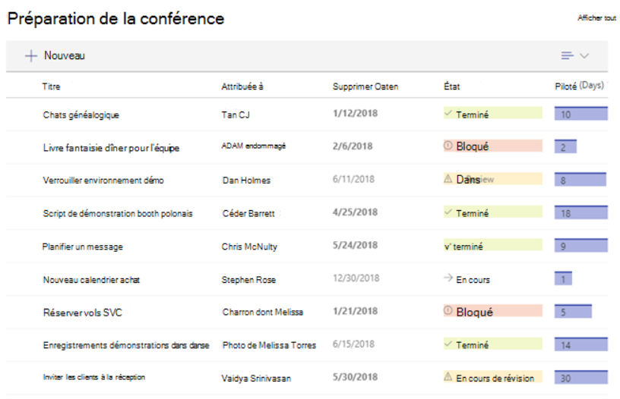
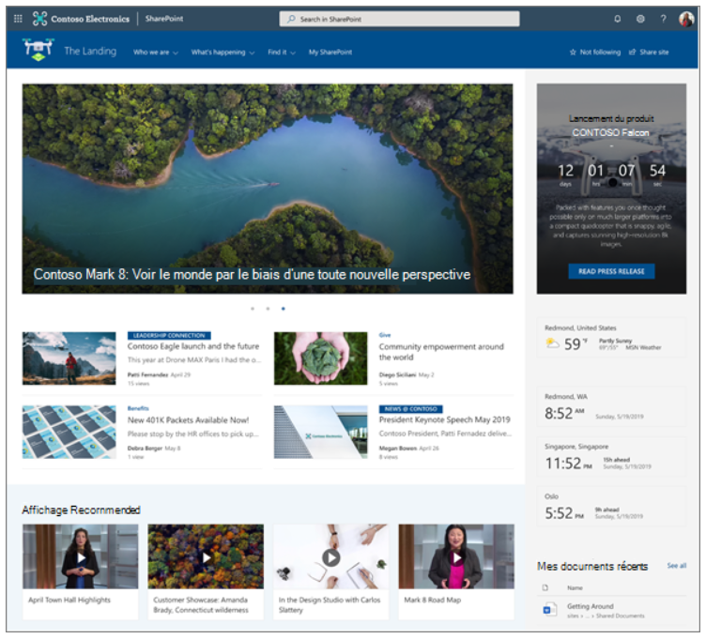
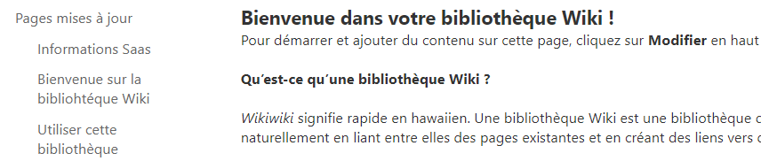
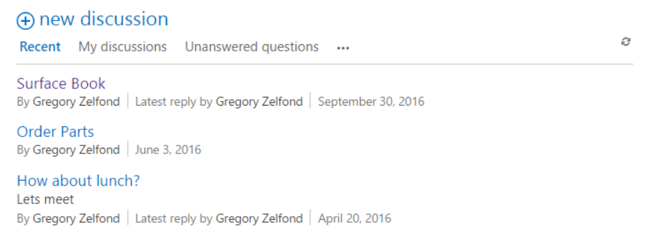
The content of a SharePoint site
A SharePoint site can contain information organized in the elements of the site. Many elements are available and here are the main ones:
Document libraries: real containers of information, there are a few variants: image libraries, form libraries.
Libraries can easily replace the file shares that abound on servers.
SharePoint lists: Pre-existing or custom, you can liken a SharePoint list to an Excel table - or an Access table - with fields (columns) and records (the list items). SharePoint has many default lists (contacts, calendars, surveys, tasks, etc.).
Web pages
Des pages Wiki
Discussion forums
Applications...
Each element can be placed on a page of the site in the form of Web Parts thanks to online editing tools.
19

Slide 20
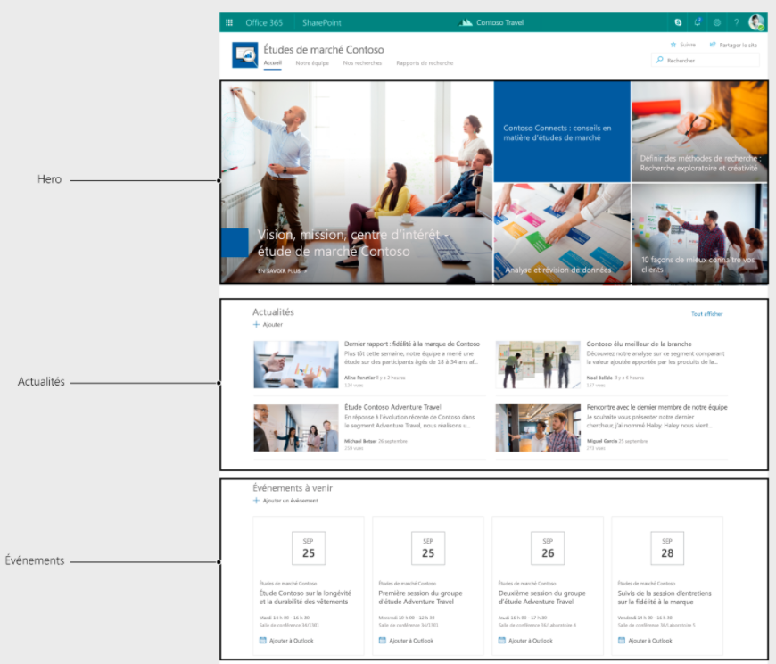
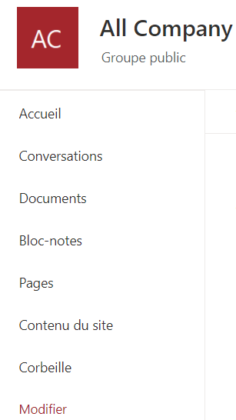
The content of a SharePoint site
Web Parts
Web Parts are SharePoint items arranged on a web page in the portal. A Web Part can display a document library, list, report, video, and so on in its area.
All the elements of a site, some of which can be accessed in the quick launch bar on the left, can be used as a Web Part. A Web Part has its own display characteristics (dimensions, sorting, filter, etc.) that are independent of the display of the original element.
The Document Library
A document library created on the site can be placed on the home page in a Web Part via the Edit button and the page editing mode. Also, the sorting in the default view of the library may be different from the sorting in the Web Part.
The Quick Launch link bar
The Quick Launch link bar groups all the elements of the site by object type (libraries, lists, forums, etc.). We'll see that the content and order of the Quick Launch bar are completely customizable. Similarly, it is possible to use certain SharePoint elements in Web Parts on a web page without a link in the Quick Launch. The tabs at the top of the page (or top link bar) allow you to differentiate between a site and its subsites. During the creation of portal elements, the creation of subsites allows you to give a well-partitioned view of the information available on the portal.
20

Slide 21
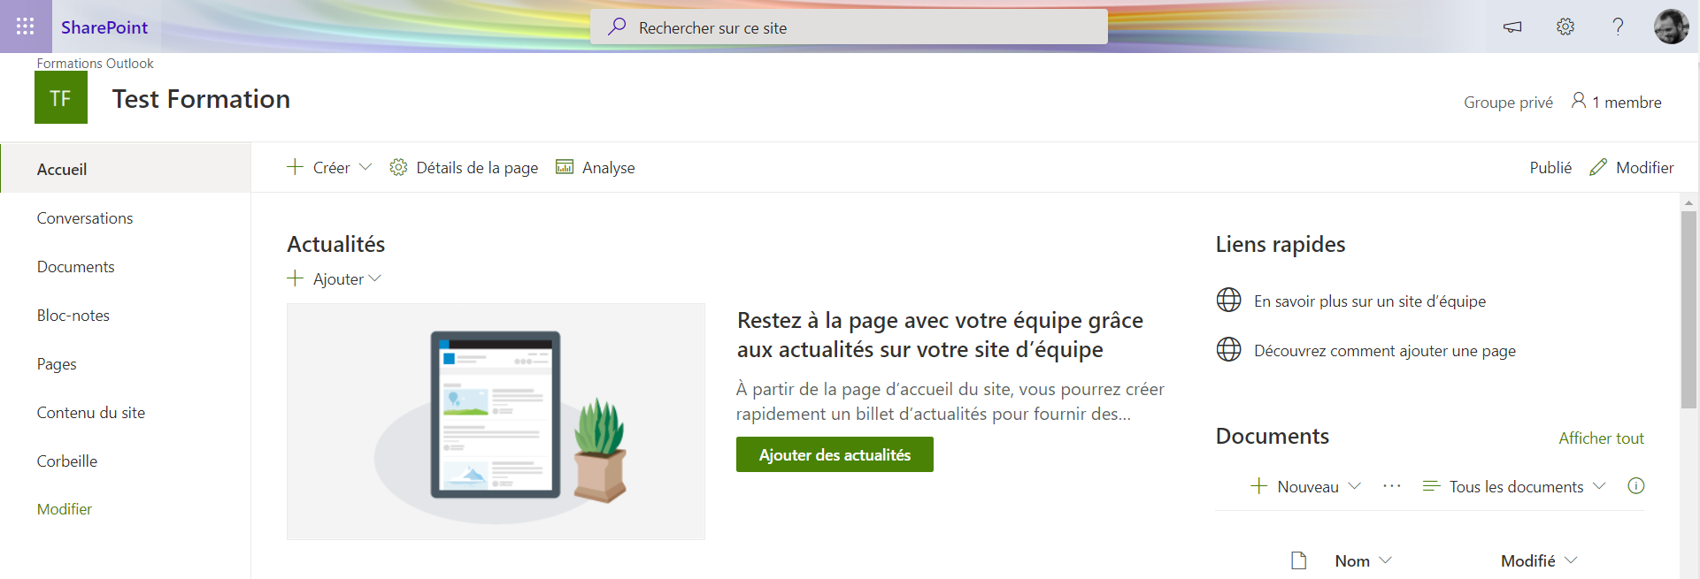
The content of a SharePoint site
The top link bar
The tabs at the top of the page (or top link bar) allow you to differentiate between a site and its subsites. During the creation of portal elements, the creation of subsites allows you to give a well-partitioned view of the information available on the portal.
The Settings button
This button is the most used by administrators. It allows:
Change site permissions (Share with command).
The creation of site elements (subsites, libraries, lists, etc.) via the Add an application command;
Switching to edit portal web pages (change the order of Web Parts, add, delete them) via the Edit Page command.
Access the Site and Site Collection Administration Settings page using the Site Settings command.
Change the theme of a site using the Change Appearance command.
21

Slide 22
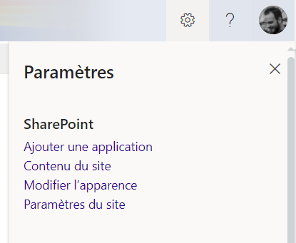
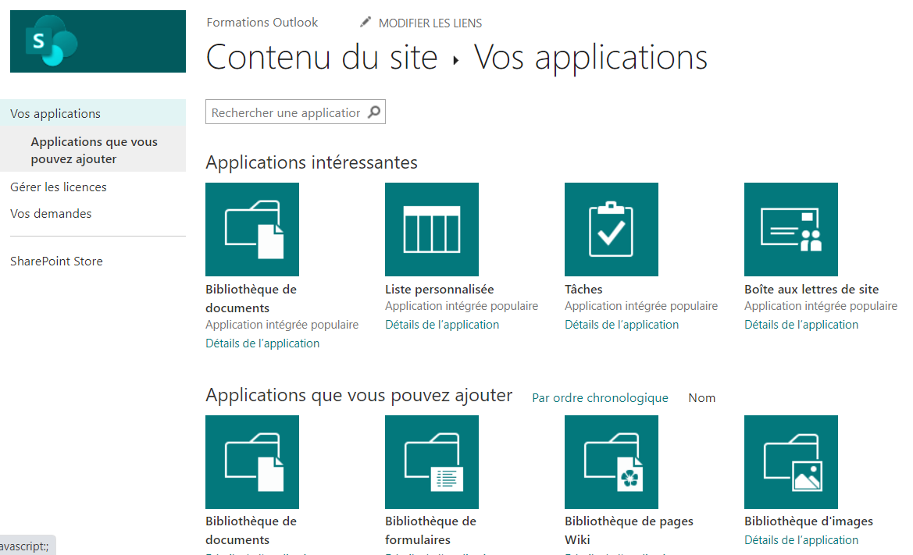
The content of a SharePoint site
Applications
It is possible to add applications to your SharePoint site such as libraries, lists, calendars, discussion forums, etc.
By extension, you note that, via the Add Application command on the Settings button, each object of type library, custom list, or already parameterized is called an application.
The Site Content link also allows you to add an object using the New button and the Add Application command.
22

Slide 23
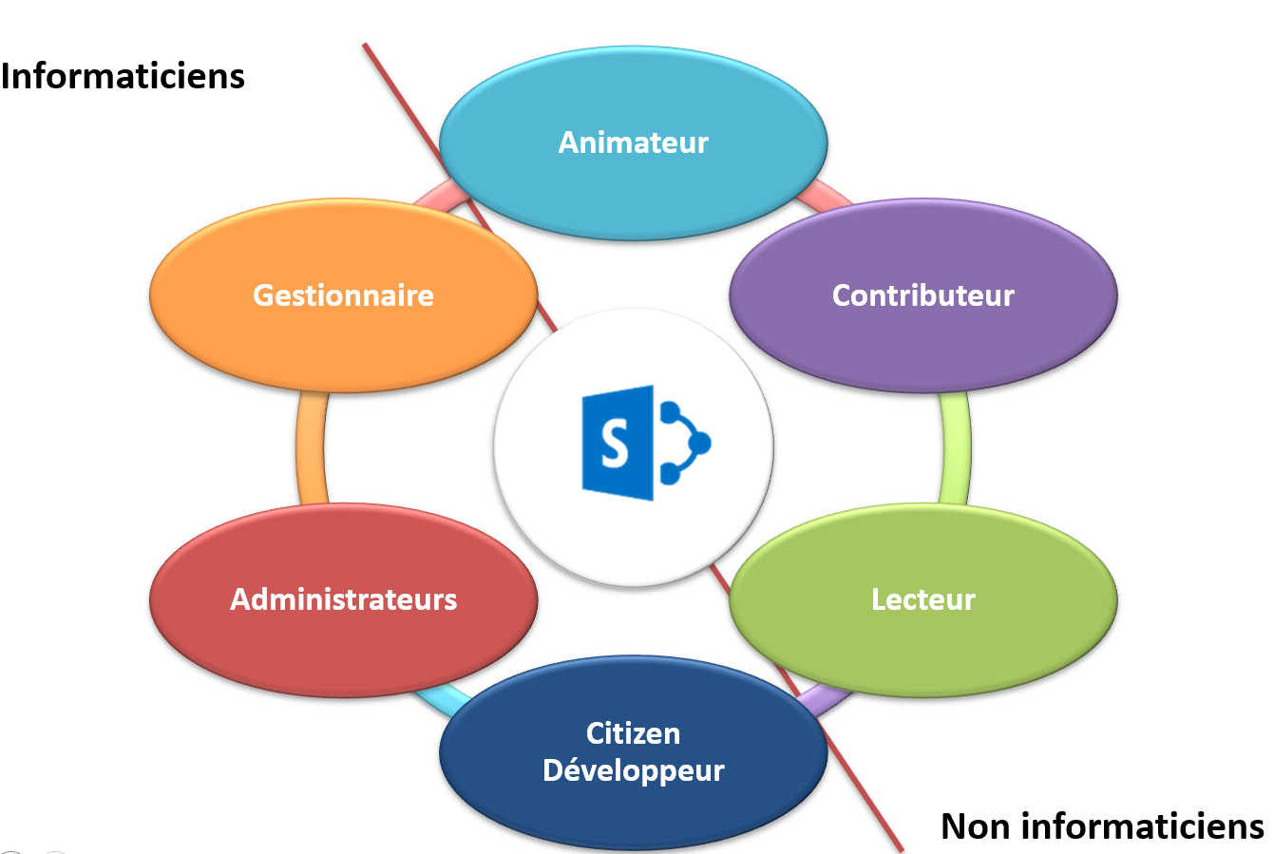
THE ROLE OF THE CONTRIBUTOR

Slide 24
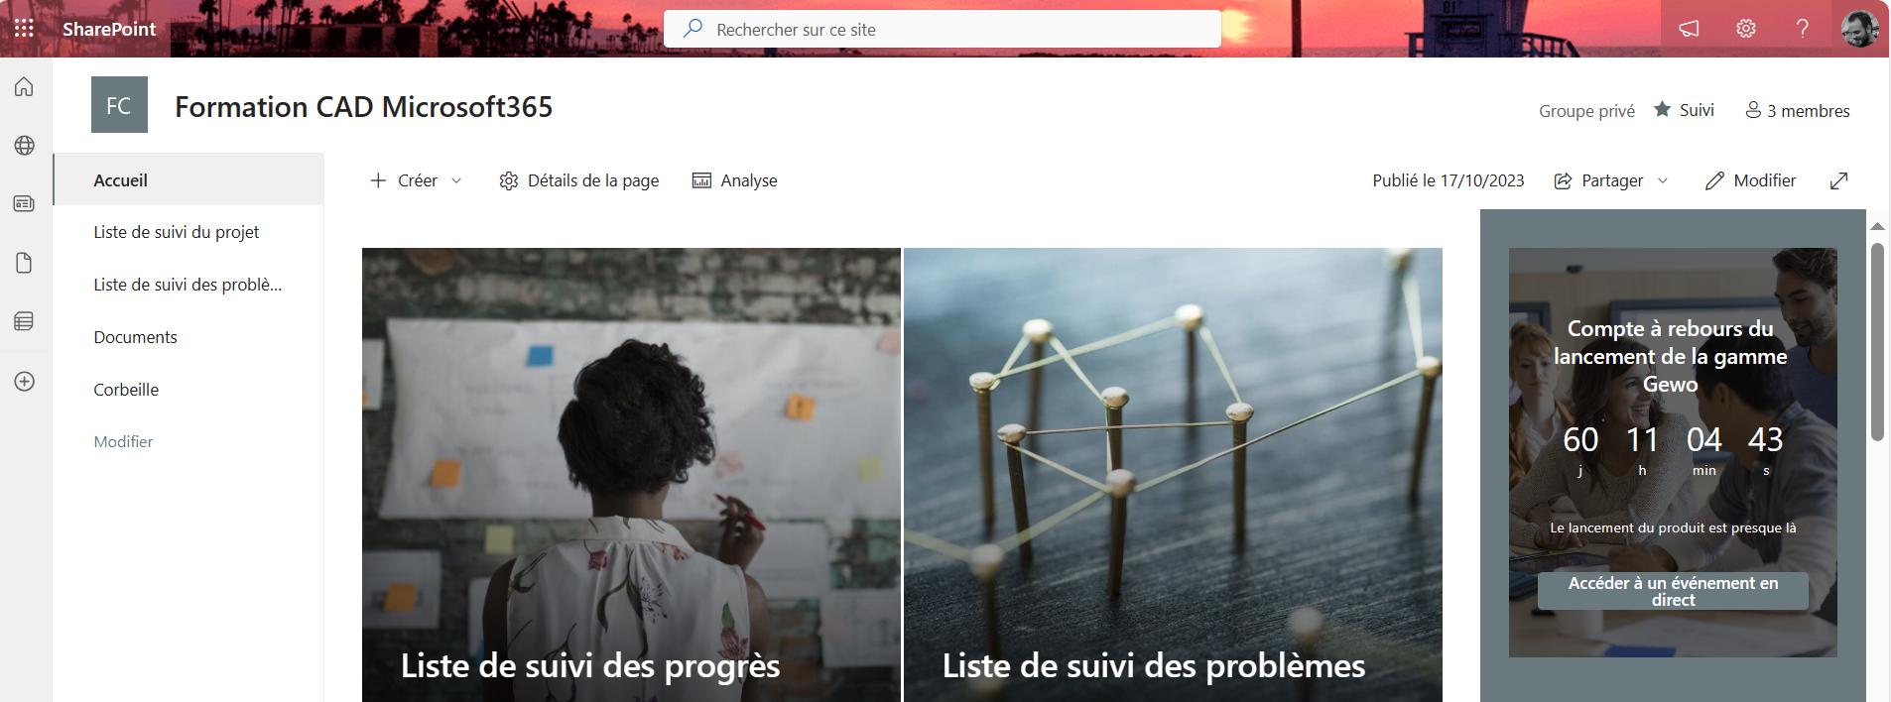
BROWSING A SHAREPOINT SITE
The Quick Launch Menu

Slide 25
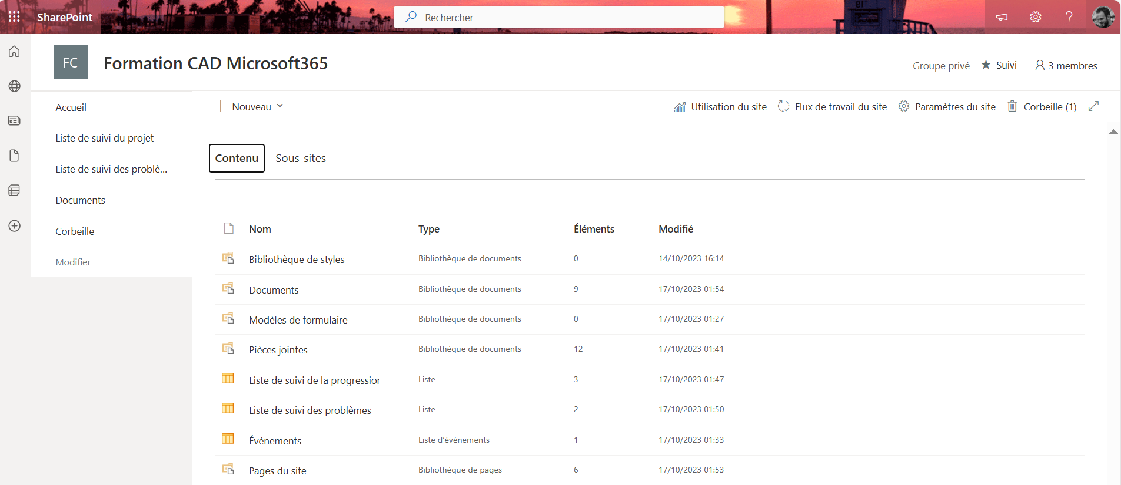
View Site Content

Slide 26
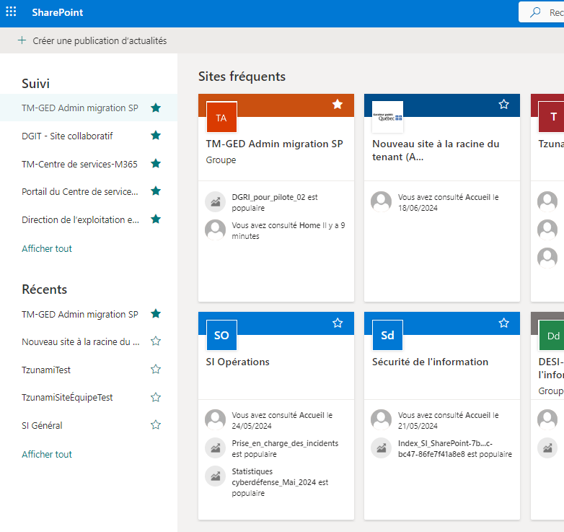
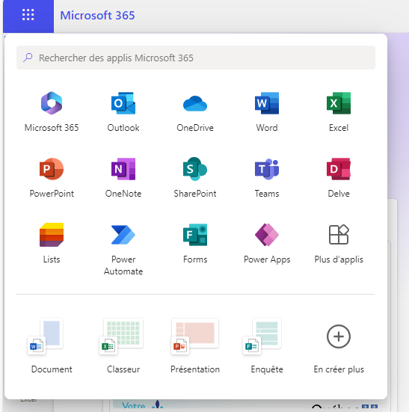
Access SharePoint sites
SharePoint sites are accessed through the SharePoint home page from the Microsoft 365 app launcher.
Sites can be favorited here.

Slide 27
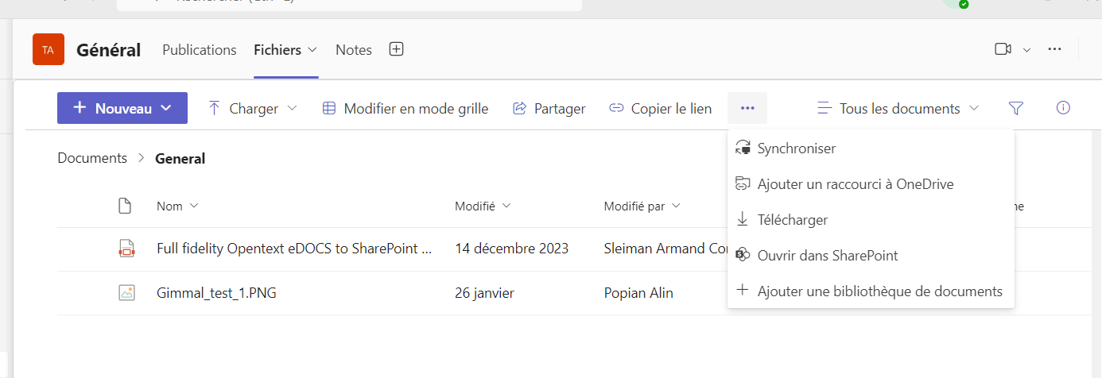
Access SharePoint sites
SharePoint sites are accessed through the file page of a Teams team.

Slide 28
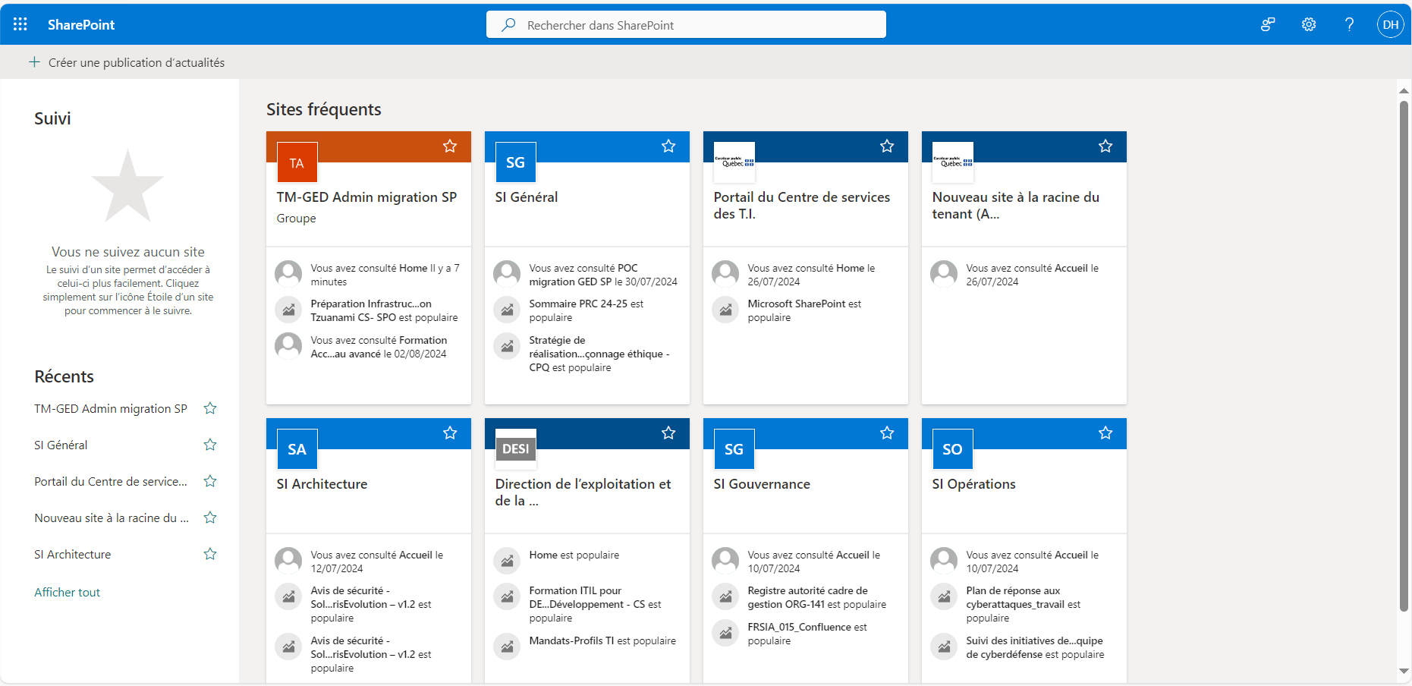


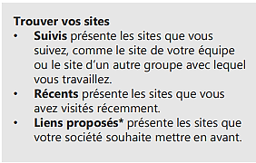
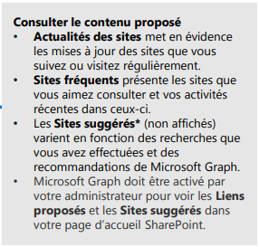
Quick Start
Be more productive anywhere with secure access, sharing, and file storage.

Slide 29
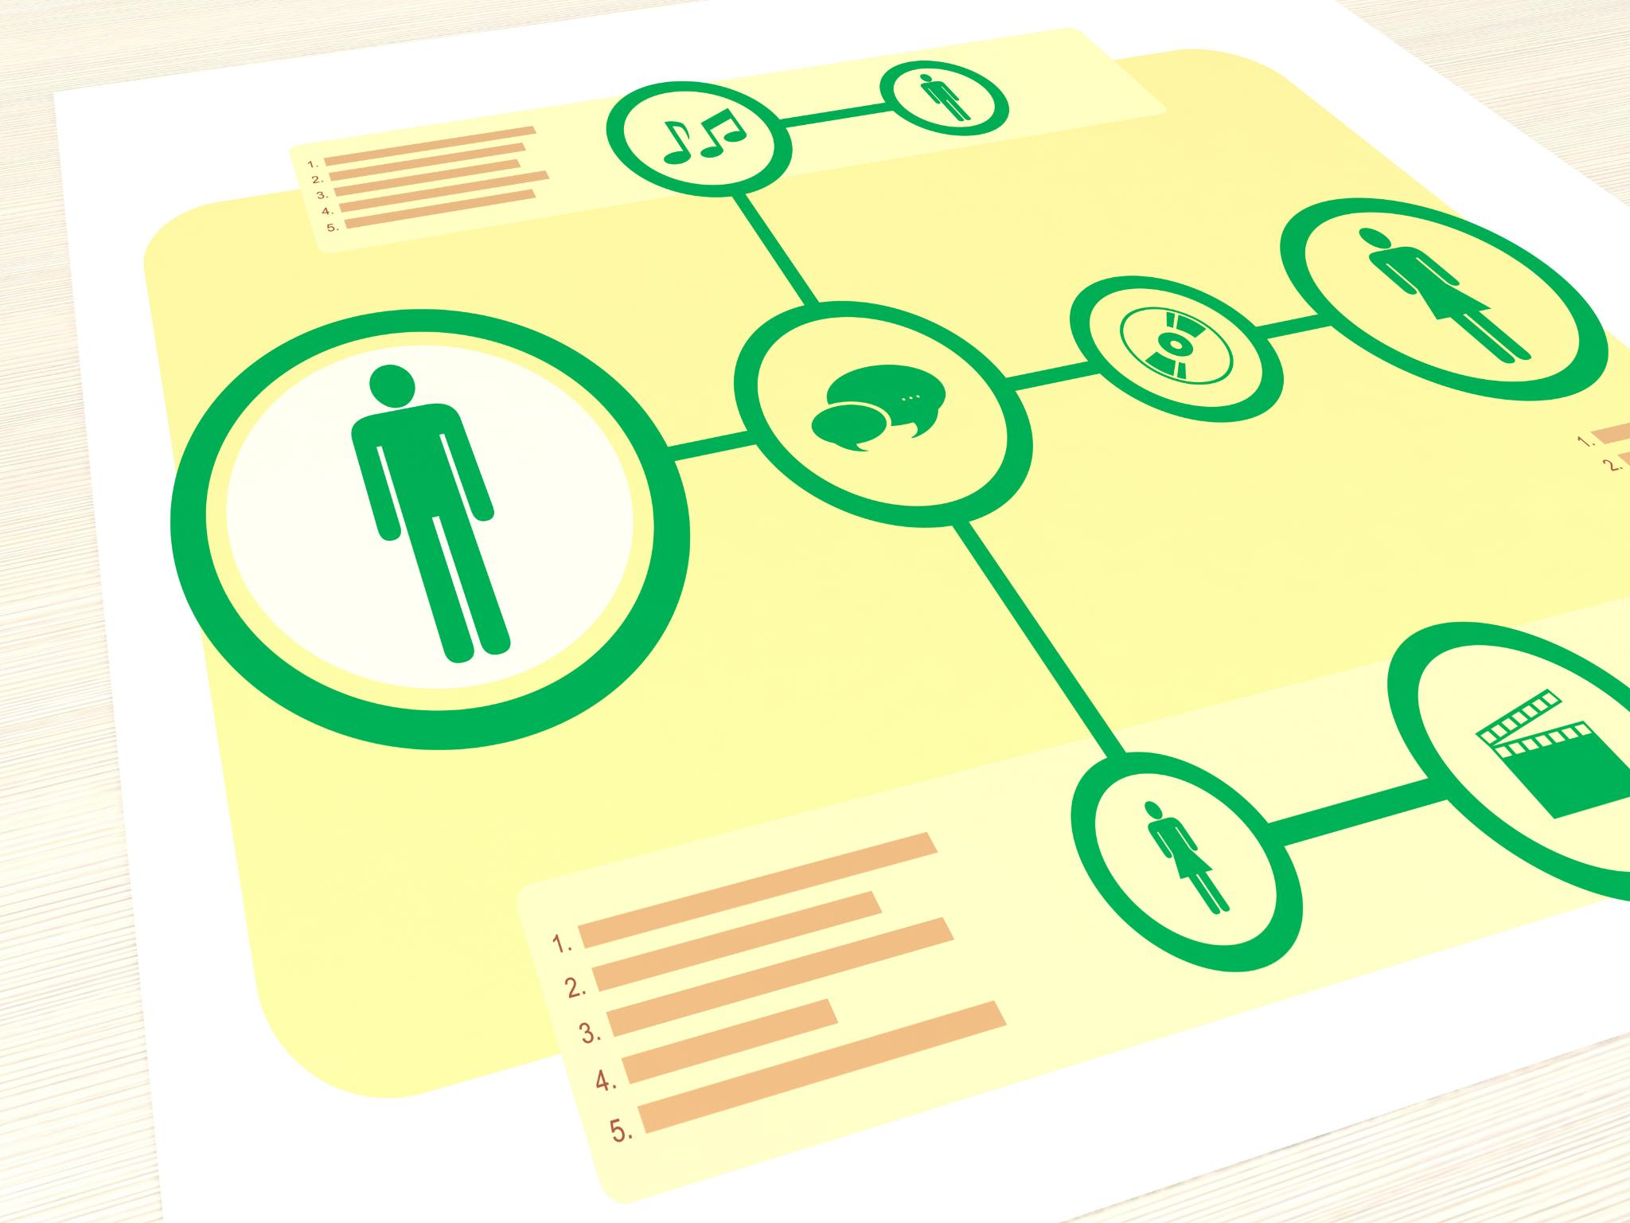

Sharepoint, Overview
With Microsoft SharePoint, you can:
1. Create intranet sites and create pages, document libraries, and lists.
2. Add web parts to customize your content.
3. Show important visuals, news, and updates with a communication team or site.
4. Discover, track, and search for sites, files, and people within your company.
5. Manage your daily routine using workflows, forms, and lists.
6. Sync and store your files in the cloud so everyone can work with you safely.
7.Keep up with the news wherever you are with the mobile app.

Slide 30
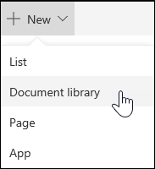
Documents and libraries in SharePoint
A document library is a place on a site where you can upload, create, update, and collaborate on files with team members.
Document libraries are often used to store a group of files with shared attributes.
A document's properties can be used to make it easier to manage and access the document with metadata.
Creating a document library in Microsoft SharePoint
Go to the Library tab in SharePoint
Click on "Create Document Library"
Fill out the form to create a new library

Slide 31
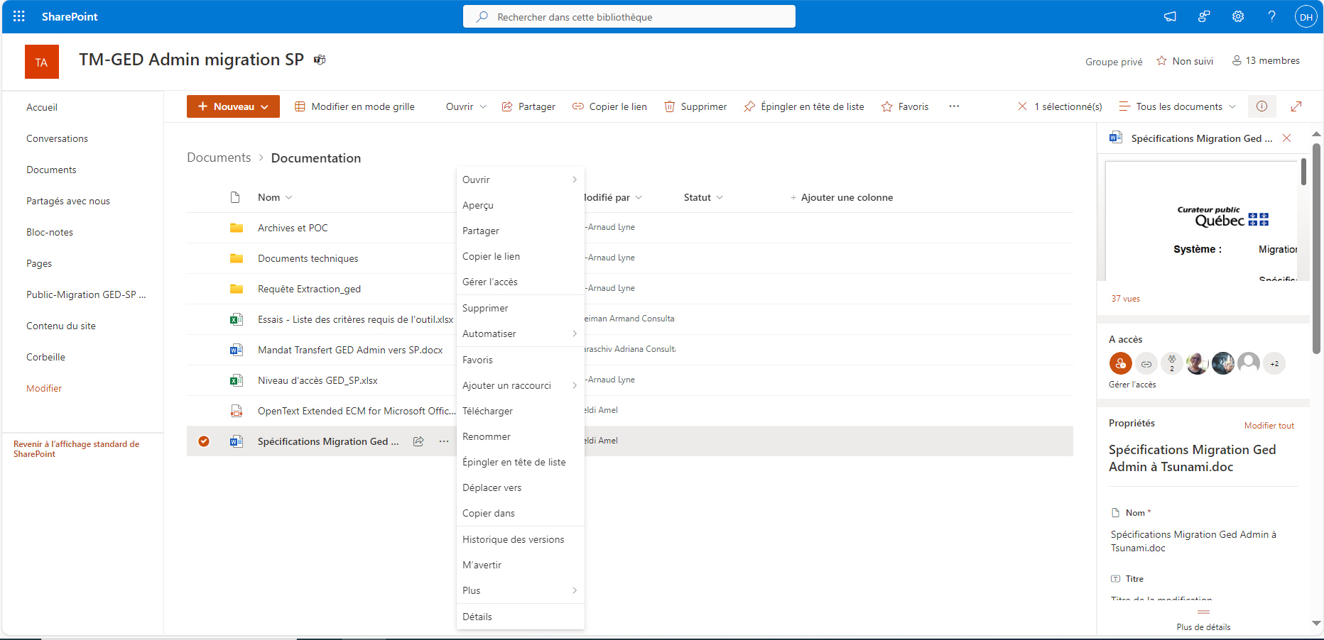

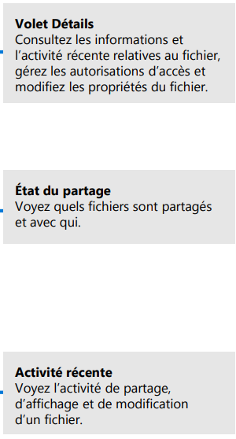

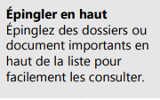

Working with Files
Select a site from the SharePoint home page or enter its URL in your browser. Select Documents in the left navigation pane.

Slide 32
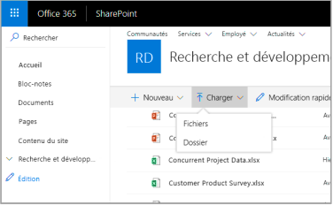
Create or upload files and folders
You can create files and folders, as well as upload files and folders.
Select Upload > files. You can also select a location in SharePoint, and then drag and drop
files or folders from your device.

Slide 33
Define a custom template for a SharePoint library
When you create a SharePoint document library, you can set a default file type to open when a new file is created (for example, you can set a PowerPoint file as the default file type to open).
You can also customize the default file template for this library. For example, you can create a Word template with custom headers and footers, or other custom features, and make it the default template for that library.
When you or your users create a new file, it opens in the appropriate program with your custom features.
Remarque : Vous devez disposer des autorisations de contrôle total pour que la bibliothèque puisse configurer un modèle.

Slide 34
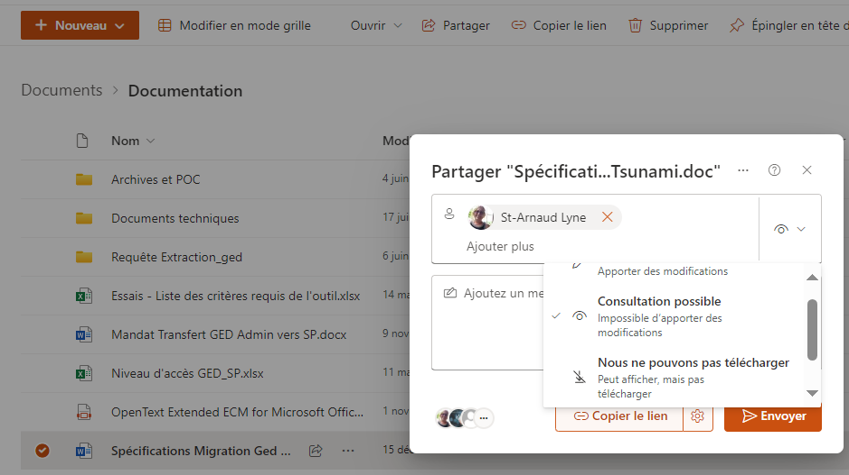

Share folders or files
Sselect a folder or file, and then choose Share. You can grant edit or view permissions to recipients, and set temporary limits on files to specify when they will cease to be accessible.

Slide 35
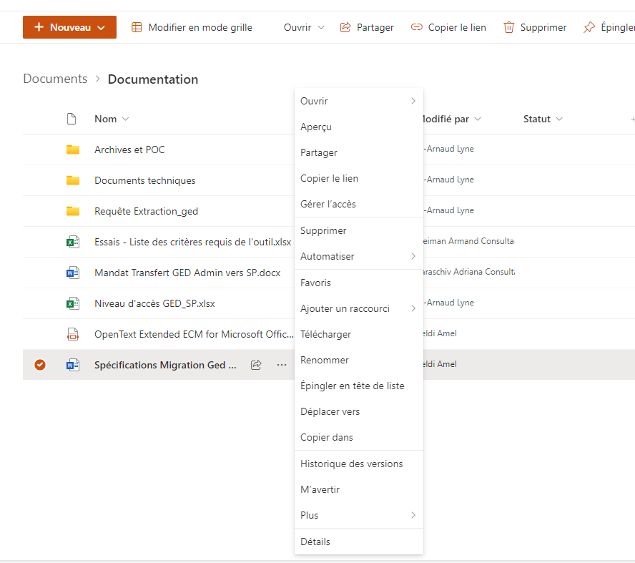
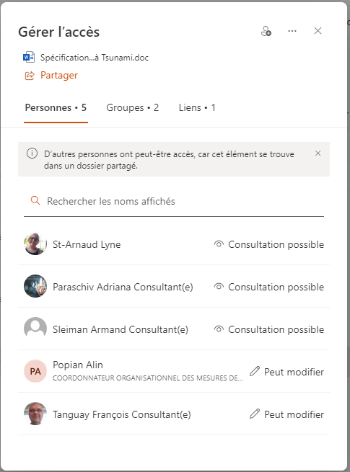
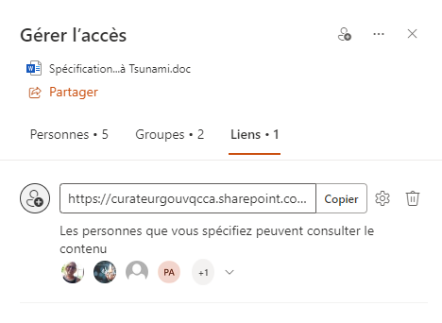
Manage access to a file or folder
Click on the ..., then choose Manage access. You can grant edit or view permissions to recipients, and set temporary limits on files to specify when they will cease to be accessible.

Slide 36
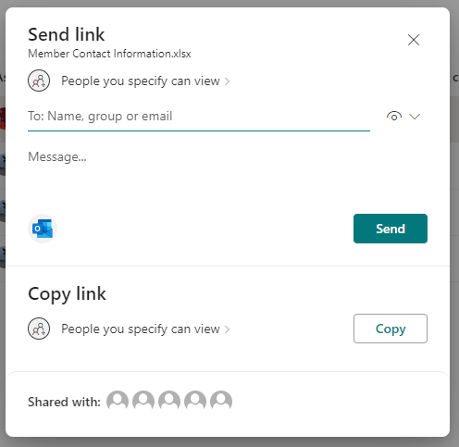
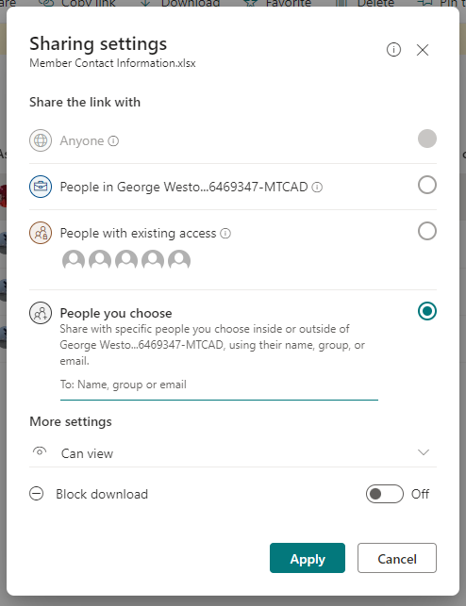


Sharing files in SharePoint
SharePoint est une plateforme de collaboration et de gestion de documents de Microsoft basée sur un navigateur. Les documents téléversés sur un site SharePoint sont automatiquement partagés avec les membres existants du site, avec la possibilité de les partager avec des utilisateurs spécifiques.
How to share a file or folder
1. Sélectionnez les fichiers ou dossiers que vous souhaitez partager en sélectionnant l’icône de cercle.
  Si vous utilisez la vue « Liste », sélectionnez le cercle sur le côté gauche de l’élément. Vous pouvez aussi choisir plusieurs éléments pour les partager ensemble.
  Si vous utilisez la vue « Vignettes », sélectionnez le cercle dans le coin supérieur droit de l’élément. Vous pouvez aussi choisir plusieurs éléments pour les partager ensemble.
2. Sélectionnez en haut de la page ou la même icône à côté du fichier ou du dossier.
3. Sous Copier le lien, sélectionnez le niveau d’accès à donner aux utilisateurs en ouvrant les paramètres de lien.
Counsel:
If the selected file or folder is already shared with someone, a Shared With list will be displayed at the bottom of the screen.
If the selected file or folder is not currently shared with someone, there will be no Shared With list.

Slide 37
Sharing files in SharePoint
It's important to understand how to share and access your files and folders. Read on to understand the different levels of access.
Types of sharing:
1
People at George Weston with the link: gives access to everyone in our organization who has the link to the file, whether they receive it directly from you or whether the link is transferred from someone else.
People who already have access: Can be used by people who already have access to the document or folder. This does not change any permissions. Use this option if you just want to send a link to someone who already has access.
Specific people: Only gives access to people you select, although other people may already have access. If people forward the sharing invitation, only people who already have access to that item will be able to use the link.
Select the Open in review mode only or Allow file editing drop-down menu.
Block download: Prevents people from downloading the file or folders they have access to. Unchecking this box means that people can download the files to their devices.
2
1
2
3
3
More Settings:

Slide 38


Sharing files in SharePoint
All files in a SharePoint site are automatically shared with site owners, members, and visitors. If you decide to stop sharing a document, access will be limited to site owners.
Stop sharing access
If you are a site owner, you can stop sharing the file or folder.
Right-click the folder or select , and then select Manage Access.

Slide 39

Delete a file, folder, or link from a document library
You can delete files, folders, or links from your SharePoint document library that you no longer need, such as old content or outdated folders.
Note: When you delete a folder, it deletes the folder and any files or subfolders within it. Consider moving or archiving the contents of the folder before deleting it. You or your administrator may be able to recover a folder and its contents from the Recycle Bin.
Restore items from the SharePoint Recycle Bin in Microsoft 365. You can restore items that you delete and items that are deleted by others (as long as you have edit permissions).

Slide 40


Copy link
You can also share a file by copying the link to it and pasting it into an email, instant message, or OneNote page. In SharePoint, select a file, and then select Copy Link. Copy the link and then paste it where you want it.

Slide 41


Pin to top
Click the three dots ..., then choose Pin to the top of the list. Right-click the file or folder you want to reorder, and then select Edit Pin. Select Move Right or Left to reorder the item.

Slide 42

Move a document or file
Click on the three dots ..., and then choose Move To. You have the option to move a document or file to another location in SharePoint: another folder, another library, or a SharePoint site.

Slide 43


Co-edit a file in Sharepoint
Several members of the same team can co-edit the same document instantly!

Slide 44



Version histories of a document
Click on the three dots ..., and then click on Version History. Right-click the space between the name and date of the item or document, and then click Version History from the menu. You'll need to scroll down the menu to view the version history. The list of versions of the file will be displayed.

Slide 45


Restore/Delete a previous version of an item or file in SharePoint.
On the Quick Launch, open the list or library.
Right-click the space between the item or document name and the date, and from the menu, select Version History. To view version history, you may need to scroll down the menu
To delete previous versions of items or files in SharePoint
Navigate to the list or library for which you want to delete a previous version.
Select Site Content, and then select the name of your list or library.
Right-click the space between the item or document name and the date, and from the menu, select Version History. To view version history, you may need to scroll down the menu.

Slide 46



Lock a file for editing or checking out
Click on the three little dots ..., then choose More, then Extract. This allows you to lock the document for a period of time to make its changes, and then unlock it to other members of the SharePoint site.

Slide 47



How to find the content of a site
The content of the site can be accessed via the gear at the top right of the screen.
The content of the site allows you to display all the elements of the site. Document libraries, lists to which the user has access are visible here.

Slide 48




Nesting SharePoint in Microsoft 365
Save your files to SharePoint from your office applications
1
1
2
1

Slide 49



OneDrive Vs SharePoint and Teams Positioning
Versus
Versus
Online collaboration tool
A company portal
Tools: document libraries, calendars, to-do lists...
Online private document storage platform
Tool: Document Library

Slide 50

Summary
General Introduction to SharePoint Online
The main functional areas of SharePoint
Why choose SharePoint for your business
Create a SharePoint site
Customize a SharePoint site
Access management in SharePoint

