Slide 1
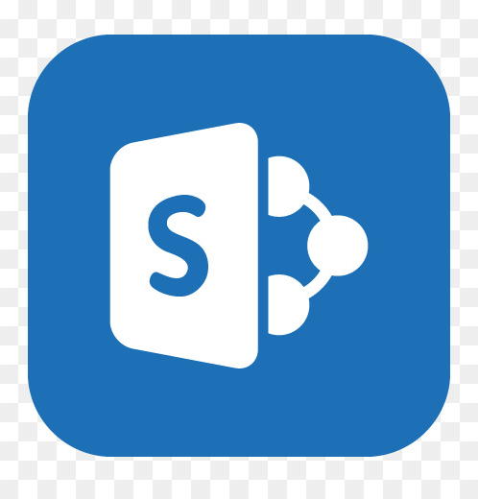
SharePoint Online
Storing and Sharing Documents

Slide 2
General Introduction
The stakes
SharePoint Online, part of the Office 365 Portal, is a collaborative platform for creating dynamic team or communication sites, project sites, business units, or departments. On these sites, authorized users will be able to store, share and organize working documents with their colleagues or external partners and much more.
Unlike SharePoint Server, this service is hosted on the Microsoft Cloud. No physical servers or internal resources are required to use it. It works in conjunction with many of the other products in the Microsoft packages available with an Office 365 or Microsoft 365 license.
The advantage is that you can work on your applications through a simple web browser.
Workflow applications, databases, libraries, lists, and a host of other Web Parts can be integrated into a secure environment.
Every business faces collaboration needs for a variety of reasons: physical distancing, workflow (movement of data from one person to another or from one department to another), privacy, etc.
It’s interesting to consider implementing SharePoint if you’re aware of the following in your organization:
The quality and regularity of the publication of information varies greatly.
The capitalization of competences at enterprise level is slow or non-existent and know-how or knowledge bases are lost, as the contents of these competences have never been formalized.
Managers who have to publish information have to repeat their tasks several times and sometimes with different IT tools.
Communication is defective or non-existent (purchases, entry of equipment, communication of products, legal documents...).
The circulation of information outside the enterprise resource planning system is very difficult and depends on the good will of the persons holding the information
If your business is facing these issues, SharePoint is highly recommended. However, SharePoint should not duplicate existing business software, it can complement it or even communicate with it (to extract data for example).
2

Slide 3


Preparing for your SharePoint implementation
The tool can be built as a knowledge base for the company. It is important that everyone adhere to this principle of capitalization and sharing of powers. The phases of learning and explaining needed for habit change should be incorporated. These actions will be phased in long after the project has been implemented, as change takes time.
As you prepare for your implementation, it is a good idea to integrate the authoring of training materials by user type and a schedule of training sessions for each user.
User interest must be raised:
From the beginning of the reflection phase, the project manager or team can rely on key users, even within a limited scope, who will be able to promote the tool in the company, participate in the evolution of the models, measure successes and failures and will be a good support for functional choices and the detection of the brakes to the adoption of such a tool.
Training for all users will be essential to ensure that everyone uses all the functionality of the tool at their level of authorization.
Through a progressive transfer of skills by population types (project team to key users to collaborators).
Highlight the benefits to users in the course of their workday.
3

Slide 4
Training, change and governance
Write materials using the hierarchy of permission levels you set up earlier:
A simple visitor will have his support of a few pages.
A user with larger rights will have a medium of one or two dozen pages.
A person with advanced rights (managing list fields, versioning, creating libraries) will have more support, etc.
This phase is an essential element that will allow management to raise awareness of the tool throughout the company, but also to provoke other reflections of users to make the portal live.
Governance is a set of policies and methods that best manage the lifecycle of an application.
Applied to enterprise computing in general, and not just to a tool like SharePoint, it is about defining a set of rules, procedures, roles that control the use of a system to achieve a goal or help the company achieve its goals.
In the context of a simple platform for an SME, the notion of governance may be less present; SharePoint will then be used for a single use, of the intranet type, with a single farm, probably composed of a single server and a single site collection...
In the case of a larger company where the product will be used for collaboration needs with partners (extranet) or public sites, governance will be involved in the project and the life of the product at all times.
Four main phases can be identified for governance:
Plan
Define application usage and management rules, define expectations and requirements
Deploy
Set up the platform, designate roles and responsibilities
Verify
Verify user adoption, manage change in working methods, audit procedures and their effectiveness.
Correct
Correct the errors and weaknesses of the first versions and start the cycle again.
4

Slide 5

Use SharePoint to create an intranet
An intranet is an application that is presented as a website for users of a private organization, as opposed to an Internet site.
The application is accessible from any device and with a simple browser by each user with an account in the company directory. The intranet is a private space, but not a personal one. Storage space and tools should be used as part of the work. This type of application is responsible for federating contributors in the enterprise.
However, the SharePoint range has "social networking" features to not only store personal profiles, but also offer dedicated content storage spaces for users. Because of its availability in software as a service (SaaS) mode, SharePoint Online extends this strict usage beyond the company’s boundaries with scenarios for sharing content to external users.
The main functional areas of SharePoint are:
Collaboration.
Personal and team productivity.
Enterprise content management.
Workflows and interoperability with management applications.
Access to knowledge: searching for content, people (providing correct information to those who need it).
Company social networks (profiles, data labeling, etc.).
Decision-making.
5

Slide 6

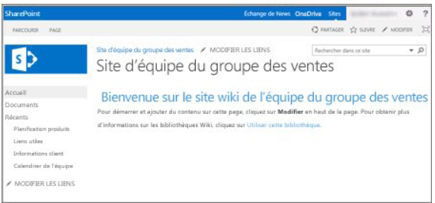
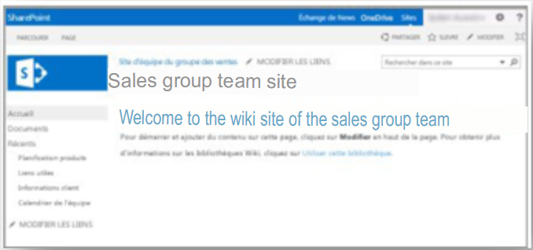
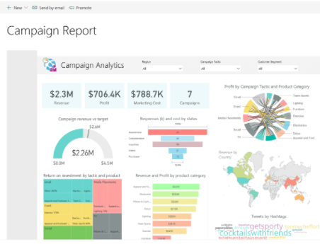
Use SharePoint to create an intranet
A SharePoint solution has many advantages, including:
Library-based document management capabilities (metadata and document type management)
Wiki page libraries allow business data to be gathered quickly and unstructured in an easily editable format.
Developing solutions or apps enables the company to implement management solutions in record time ( Power Apps)
6

Slide 7
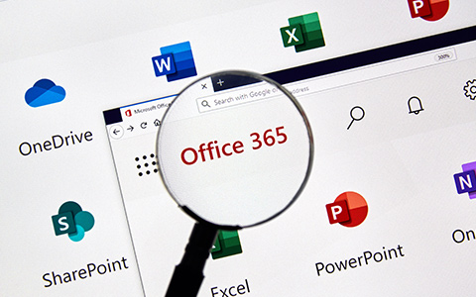
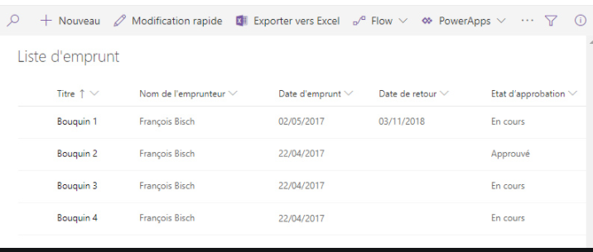
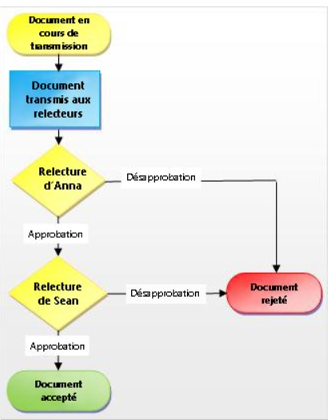
Use SharePoint to create an intranet
Extensive integration of Microsoft Office Suite software makes collaboration between people a reality every day
Pre-existing SharePoint lists allow you to manage team schedules, create highly targeted sites, surveys, small project management...
Workflows can be integrated to track business processes in information flow and processing (Power Automate)
7

Slide 8
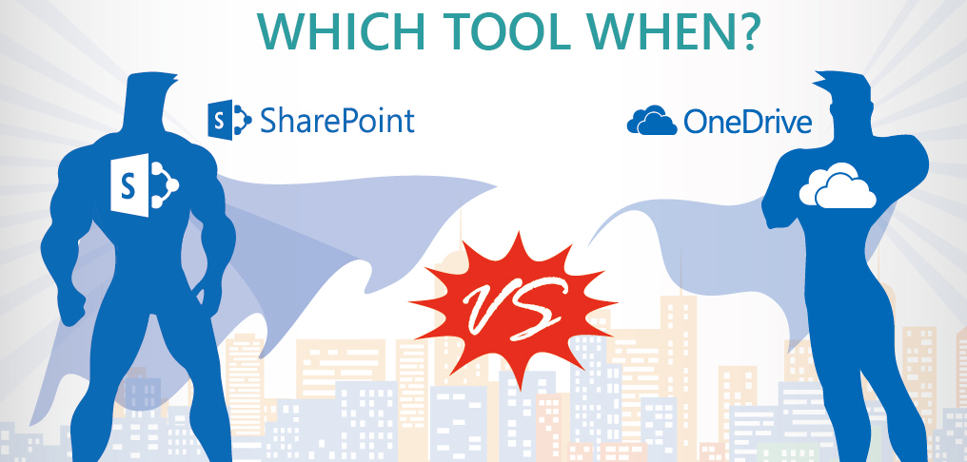
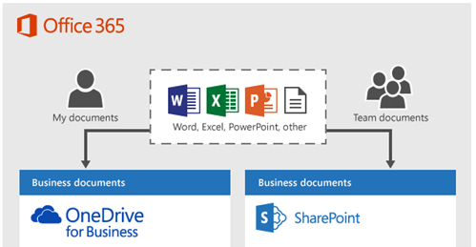
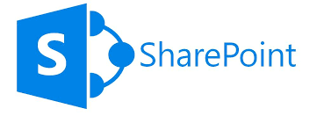
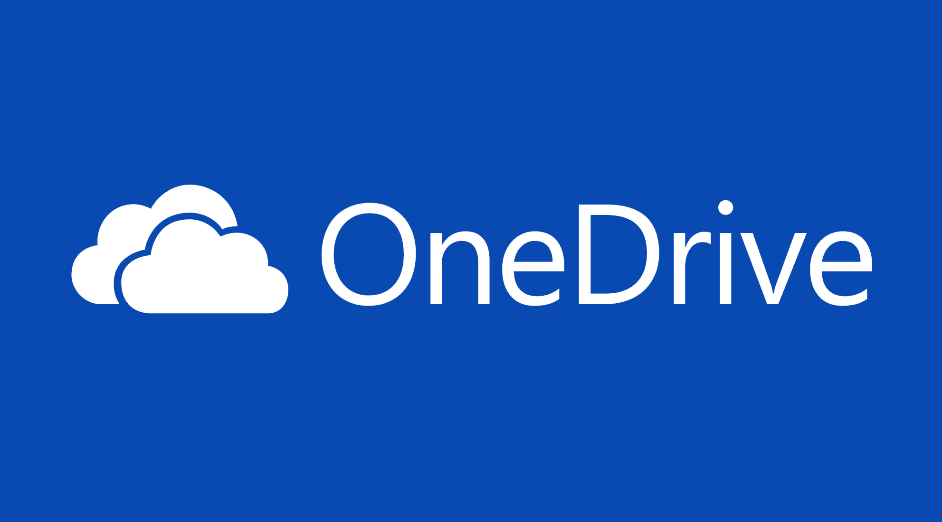
OneDrive Vs SharePoint and Teams Positioning
Online Collaboration Tool
A business portal
Tools: document libraries, calendars, task list...
Teams
Store business documents for your own use in OneDrive for Business. You can search and edit your documents or share them with specific people. And you can synchronize them on your computer or device.
Store documents for a team in a team site. For example, store team plans updated by all, or meeting agendas. All team members can find and edit documents from their own computers or devices.
Online private document storage platform
Tool: document library
8

Slide 9
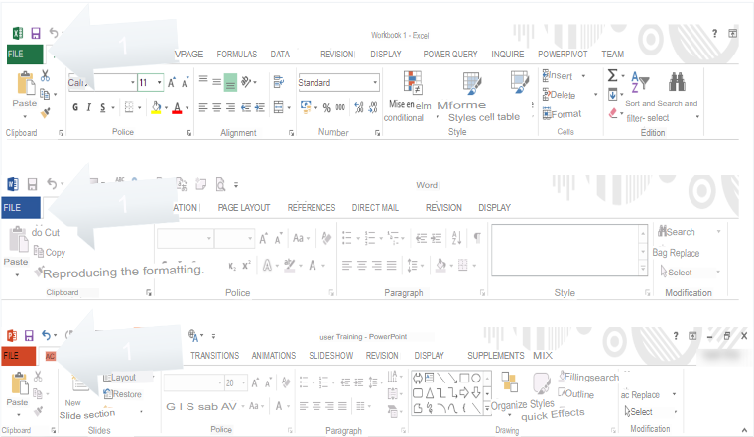
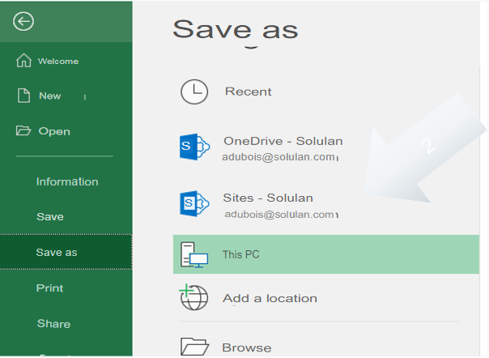
SharePoint nesting in Office 365
Save your files to SharePoint from your desktop applications

Slide 10
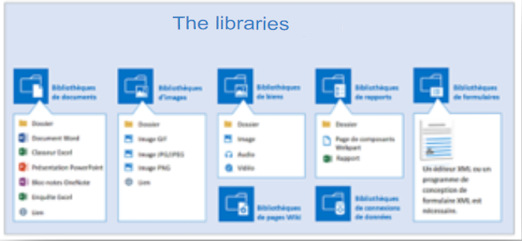
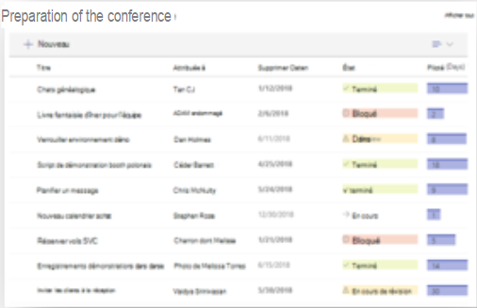
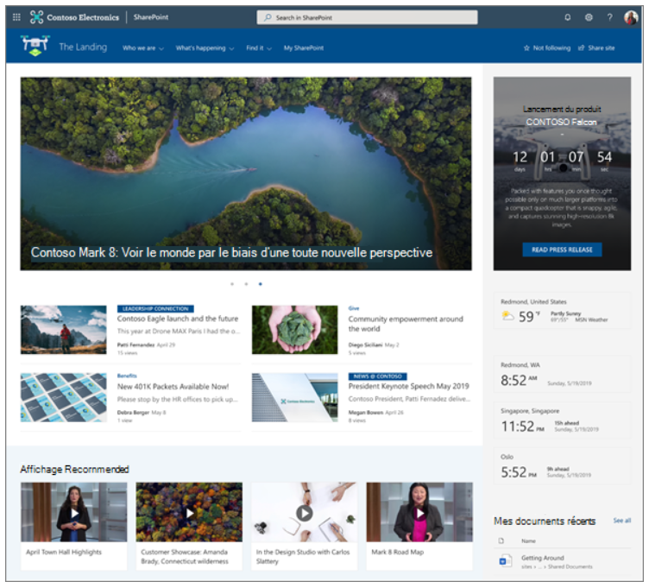
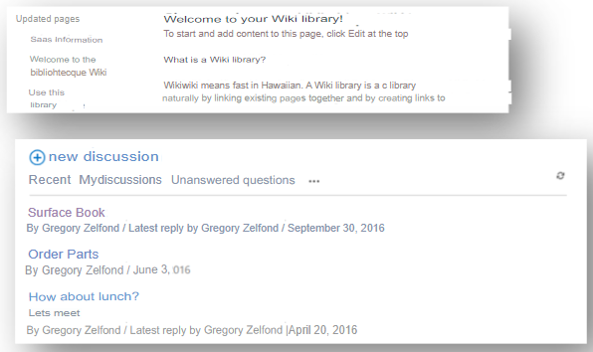
The contents of a SharePoint site
A SharePoint site can contain organized information in the items on the site. Many elements are available and here are the main ones:
Document libraries: true containers of information, there are some variants: image libraries, form libraries.
Libraries can easily replace the file shares that proliferate on servers.
SharePoint lists: Pre-existing or custom, you can think of a SharePoint list as an Excel table - or an Access table - with fields (columns) and records (the list items). SharePoint has many default lists (contacts, calendars, surveys, tasks...).
Web pages
Wiki pages
Discussion Forums
Apps...
Each item can be placed on a page of the site as Web Parts using online editing tools.
10

Slide 11
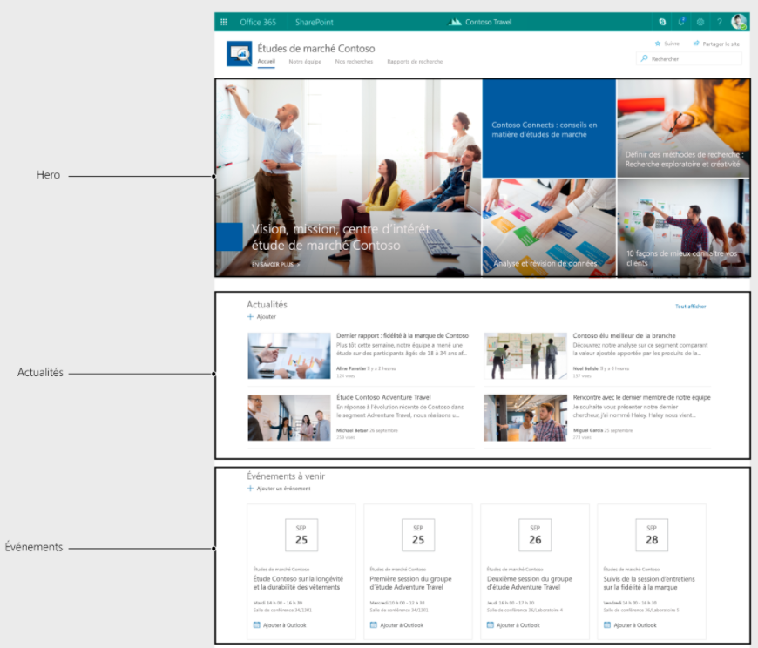
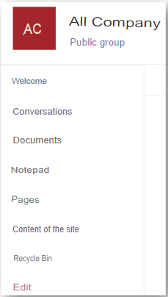
The contents of a SharePoint site
Web Parts
Web Parts are SharePoint items that are placed on a Web page in the portal. A Web Part can display a document library, list, report, video, and so on in its zone.
All items in a site, some of which are available in the Quick Launch bar on the left, can be used as Web Parts. A Web Part has its own display characteristics (dimensions, sorting, filter...) independent of the display of the original item.
The document library
A document library created on the site can be placed on the home page in a Web Part by using the Edit button and page editing mode. In addition, sorting in the default library view may differ from that in the Web Part.
The Quick Launch link bar
The Quick Launch link bar groups all items in the site (libraries, lists, forums, and so on) by object type. We will see that the content and order of the Quick Launch bar are completely customizable. Similarly, you can use certain SharePoint items in Web Parts on a Web page without a link in the Quick Launch. The tabs at the top of the page (or top link bar) are used to distinguish a site from its subsites. When creating portal elements, creating subsites provides a well-siloed view of the information available on the portal.
11

Slide 12
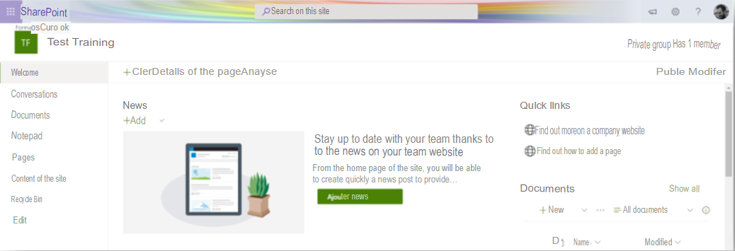
The contents of a SharePoint site
The top link bar
The tabs at the top of the page (or top link bar) are used to distinguish a site from its subsites. When creating portal elements, creating subsites provides a well-siloed view of the information available on the portal.
The Settings button
Finally, note the Settings button at the top right of each portal page, to the left of the user button. This button is most commonly used by administrators. It allows:
Change site permissions (Share With command)
The creation of the elements of the site (subsites, libraries, lists...) via the Add an application command;
Changing the order of the Web Parts to edit mode of the web pages of the portal (changing the order of the Web Parts, adding new Web Parts, removing Web Parts) using the Edit Page command;
Access the Site and Site Collection Administration Settings page through the Site Settings command.
Change the theme of a site using the Change Appearance command.
12

Slide 13
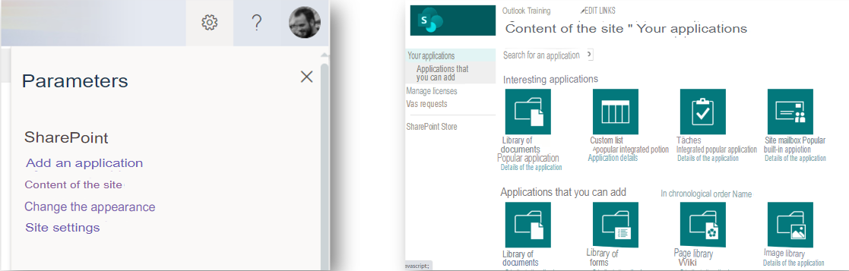
The contents of a SharePoint site
Applications
You can add applications to your SharePoint site, such as libraries, lists, calendars, discussion boards, and more.
By extension, you note that, using the Add Application command of the Settings button, each library, custom list, or already parameterized object is called an application.
The Site Content link also allows you to add an object using the New button and the Add Application command.
13

Slide 14
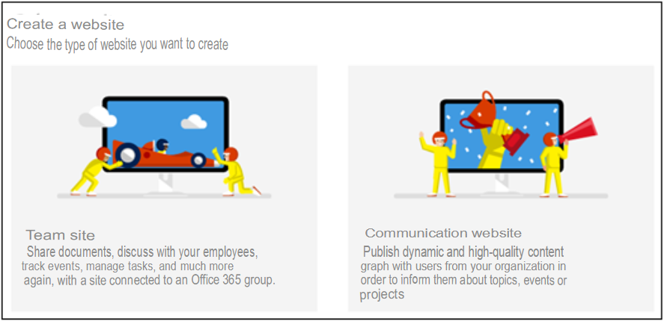
Create a SharePoint site
Team site or communication site?
You can use a team site to collaborate with your team members or even with outsiders. With a team site, all (or most) members can usually contribute to the content of the site.
If you simply want to disseminate information to a wide audience, it is recommended to use a communication site. In this case, only a small group of members can usually contribute content used by a much larger audience.

Slide 15

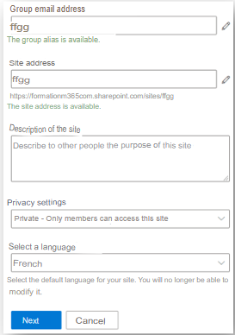
Create a SharePoint site
From your SharePoint home page, click Create Site
Choose the type of site: Team or Communication.
Fill in the required fields
If the site is public, beware. This means that all company employees can access this site without prior approval. In addition, they will have a publisher’s right, meaning that they can potentially delete its content. It's not very secure.
For all your sites, except for exceptions, choose a private group. Only invited people will be able to see the content and as a member they will not be able to administer the site ( delete content...)

Slide 16
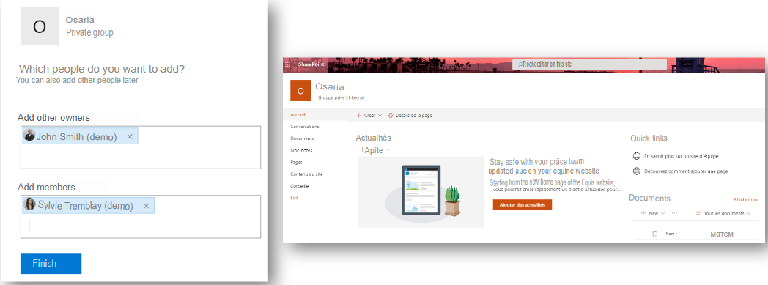
Create a SharePoint site
You can now or later add additional owners and members.
Then validate the creation, your SharePoint site is ready!

Slide 17
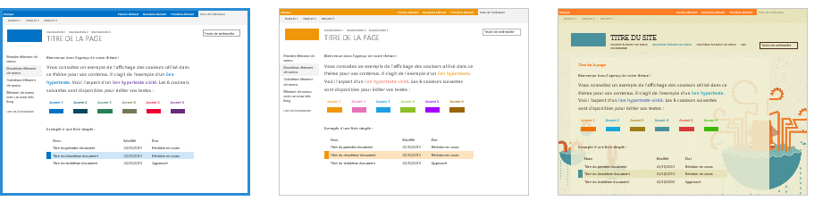
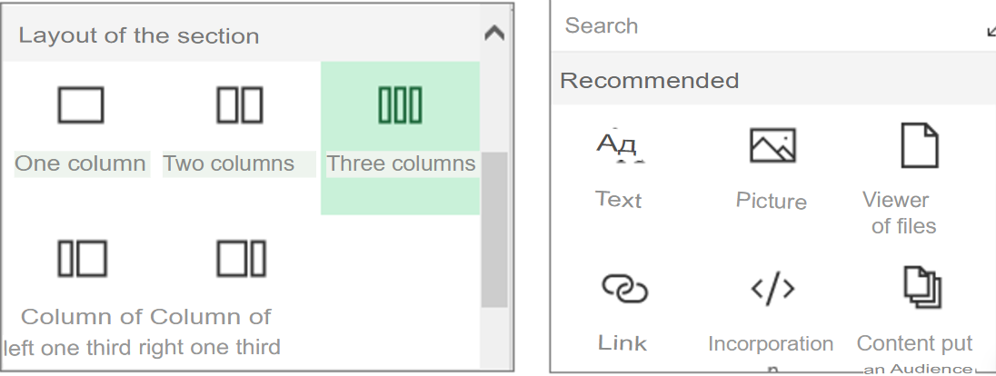
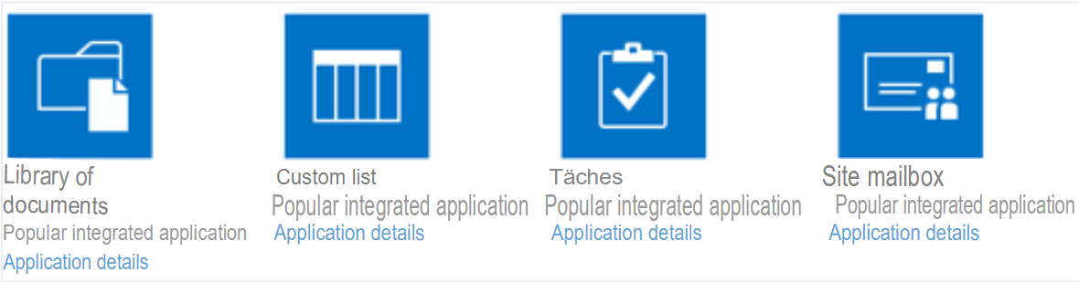
Customize a SharePoint site
Choose a theme and change the appearance
Create, edit, and customize sections and pages in your site using rich, dynamic layouts.
Add Web Parts
Add and customize content: Libraries, lists, tasks, discussion board...

Slide 18
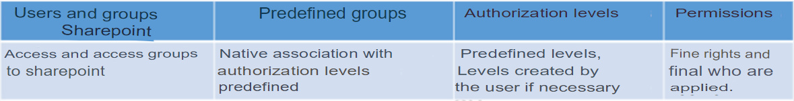
Managing Access in SharePoint
Manage Permissions
Create Permission Groups
Customize permission levels
Security is applied hierarchically and by inheritance
This inheritance can be broken at the site, list, or library level to provide specific access
Members
Visitors
Owners
Full Access
Collaboration
Read-only
Parent Site
Subsite
Subsite
Library
Folder
Item
Subfolder
Item
Item
List

Slide 19
Managing access in SharePoint Online
You can share your site or site content with anyone!
Internal
External
Sharing options:
Everyone grants access to people who receive the link, whether they receive it directly from you or whether it has been transferred by a third party.
People who already have access can be used by people who already have access to the document or folder. Use this option if you just want to send a link to someone who already has access.
Specific people grants access only to people you specify. If the link is transferred, only people who already have access to the item will be able to use the link.
By default, Allow Editing is enabled. If you want users to be able to view only your files, clear the check box.
Parent Site
Subsite
Subsite
Library
Folder
Item
Subfolder
Item
Item
List
You choose what you want to share:
The entire site
A library or list
A folder
A file

Slide 20
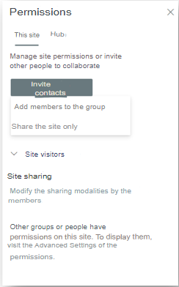
Managing Access in SharePoint Online
Share access to your SharePoint site
From the cogwheel under Site Permissions, you can find the Invite Contacts button
If you choose Add members to this group, the guest will have access to all resources in the Office 365 group ( SP site, Teams team, and so on)
If you only want to give access to the SP site, choose Share this site only.
There are 3 default groups ( visitors, members, and owners), but you can create new groups with specific permission levels in Advanced Permission Settings.
Choose the permission level that you grant to your guest, and then click Add.

Slide 21
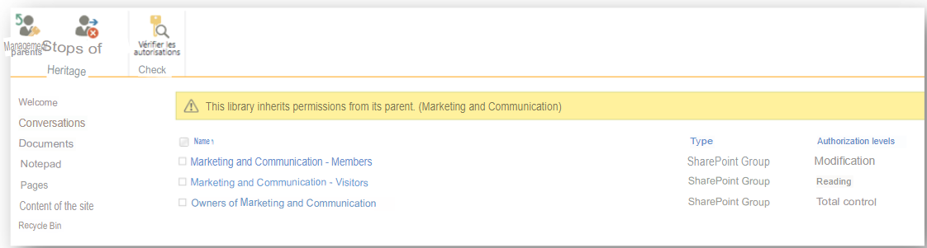
Managing Access in SharePoint Online
Share access to an SP library or list
We do not wish to share the entire SP site but only give access to the document library of our site.
Start by creating your SharePoint group that will provide access to the targeted library.
Choose the permission level you want, validate, and then add the members to the group.
Then go to the library or targeted list.
Click the gear wheel and then click Library Settings
Select Permissions for Component: Document Library
You will be presented with the following screen:

Slide 22
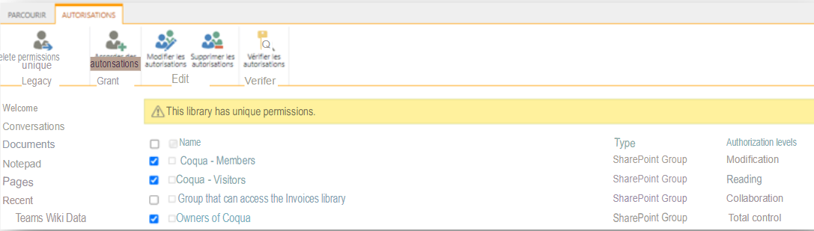
Managing Access in SharePoint Online
Click Stop inheriting permissions to create unique permissions.
Now you see a ribbon saying, This library has unique permissions.
You can now delete all SharePoint groups except the one you created for this library. Only members in this group will be able to access it.

Slide 23
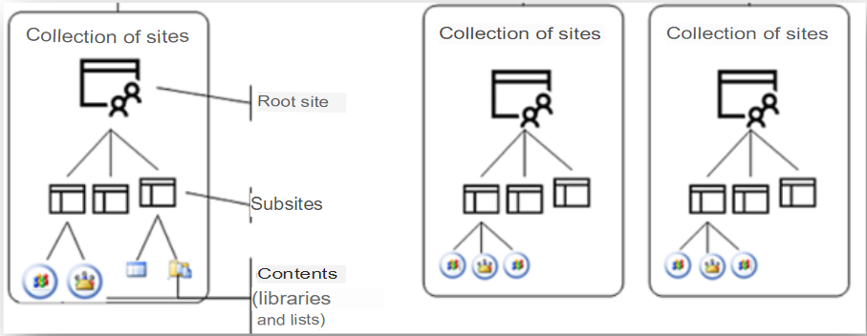
Architecture in SharePoint
Site collections
The site collection represents the content (data) of a SharePoint portal. A site collection contains a root site and subsites from the same path called management paths. The diagram below summarizes this architecture.
Each site collection contains a root site and, if necessary, one or more subsites, always for reasons of classification of the information published and exchanged. Each site contains a set of pages and applications in the SharePoint language that are libraries (of documents, images), lists, or applications available from the SharePoint Store.
Why create multiple site collections?
Examples include:
Organizational reasons: Each department of the enterprise uses information that other departments should not have access to or should be managed by different administrators.
navigation or content types must be siloed.
23

Slide 24
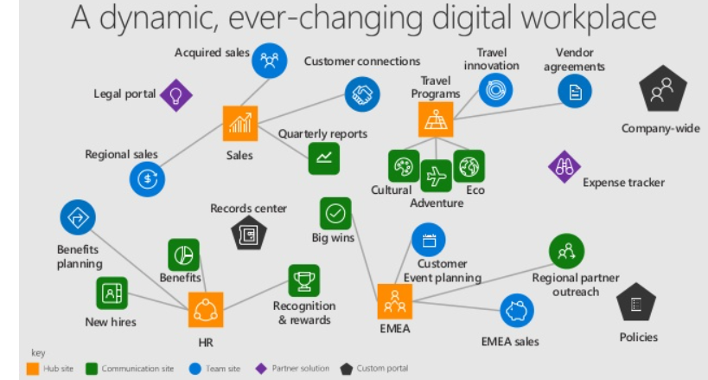
Architecture in SharePoint
The Hubs
SharePoint hub sites help you meet the needs of your organization by connecting and organizing site collections by project, department, region, and so on.
This makes it possible:
discover related content such as news and other site activities
apply common navigation and appearance to all associated sites
search all related sites
Some examples:
It is possible to bring all our project SharePoint sites under a Projects Hub.
It is possible to bring all our department SharePoint sites under a Departments Hub.
For a small business, you can envisage a single Enterprise Hub (acting as the company’s home page) to access the various departments and projects of the company.
Hub benefits:
Common navigation on all Hub sites
Unified search across all Hub sites
Change the appearance of all your sites in 1 click ( toothed wheel)
Check the events and news of all the Hub sites from your homepage
24

