Slide 1
SharePoint Online
Super User and Site Designer Part 2

Slide 2
Agenda
Security Management
Pages and Apps
Web Parts

Slide 3
General Introduction
The stakes
SharePoint Online, part of the Office 365 Portal, is a collaborative platform for creating dynamic team or communication sites, project sites, business units, or departments. On these sites, authorized users will be able to store, share and organize working documents with their colleagues or external partners and much more.
Unlike SharePoint Server, this service is hosted on the Microsoft Cloud. No physical servers or internal resources are required to use it. It works in conjunction with many of the other products in the Microsoft packages available with an Office 365 or Microsoft 365 license.
The advantage is that you can work on your applications through a simple web browser.
Workflow applications, databases, libraries, lists, and a host of other Web Parts can be integrated into a secure environment.
Every business faces collaboration needs for a variety of reasons: physical distancing, workflow (movement of data from one person to another or from one department to another), privacy, etc.
It’s interesting to consider implementing SharePoint if you’re aware of the following in your organization:
The quality and regularity of the publication of information varies greatly.
The capitalization of competences at enterprise level is slow or non-existent and know-how or knowledge bases are lost, as the contents of these competences have never been formalized.
Managers who have to publish information have to repeat their tasks several times and sometimes with different IT tools.
Communication is defective or non-existent (purchases, entry of equipment, communication of products, legal documents...).
The circulation of information outside the enterprise resource planning system is very difficult and depends on the good will of the persons holding the information
If your business is facing these issues, SharePoint is highly recommended. However, SharePoint should not duplicate existing business software, it can complement it or even communicate with it (to extract data for example).
3

Slide 4
Preparing for your SharePoint implementation
The tool can be built as a knowledge base for the company. It is important that everyone adhere to this principle of capitalization and sharing of powers. The phases of learning and explaining needed for habit change should be incorporated. These actions will be phased in long after the project has been implemented, as change takes time.
As you prepare for your implementation, it is a good idea to integrate the authoring of training materials by user type and a schedule of training sessions for each user.
User interest must be raised:
From the beginning of the reflection phase, the project manager or team can rely on key users, even within a limited scope, who will be able to promote the tool in the company, participate in the evolution of the models, measure successes and failures and will be a good support for functional choices and the detection of the brakes to the adoption of such a tool.
Training for all users will be essential to ensure that everyone uses all the functionality of the tool at their level of authorization.
Through a progressive transfer of skills by population types (project team to key users to collaborators).
Highlight the benefits to users in the course of their workday.
4

Slide 5
Training, change and governance
Write materials using the hierarchy of permission levels you set up earlier:
A simple visitor will have his support of a few pages.
A user with larger rights will have a medium of one or two dozen pages.
A person with advanced rights (managing list fields, versioning, creating libraries) will have more support, etc.
This phase is an essential element that will allow management to raise awareness of the tool throughout the company, but also to provoke other reflections of users to make the portal live.
Governance is a set of policies and methods that best manage the lifecycle of an application.
Applied to enterprise computing in general, and not just to a tool like SharePoint, it is about defining a set of rules, procedures, roles that control the use of a system to achieve a goal or help the company achieve its goals.
In the context of a simple platform for an SME, the notion of governance may be less present; SharePoint will then be used for a single use, of the intranet type, with a single farm, probably composed of a single server and a single site collection...
In the case of a larger company where the product will be used for collaboration needs with partners (extranet) or public sites, governance will be involved in the project and the life of the product at all times.
Four main phases can be identified for governance:
Plan
Define policies for use, application management, expectations and requirements
Deploy
Install platform, designate roles and responsibilities
Verify
Verify user adoption, manage change in working methods, audit procedures and their effectiveness.
Correct
Correct errors and weaknesses in early releases and restart the cycle.
5

Slide 6
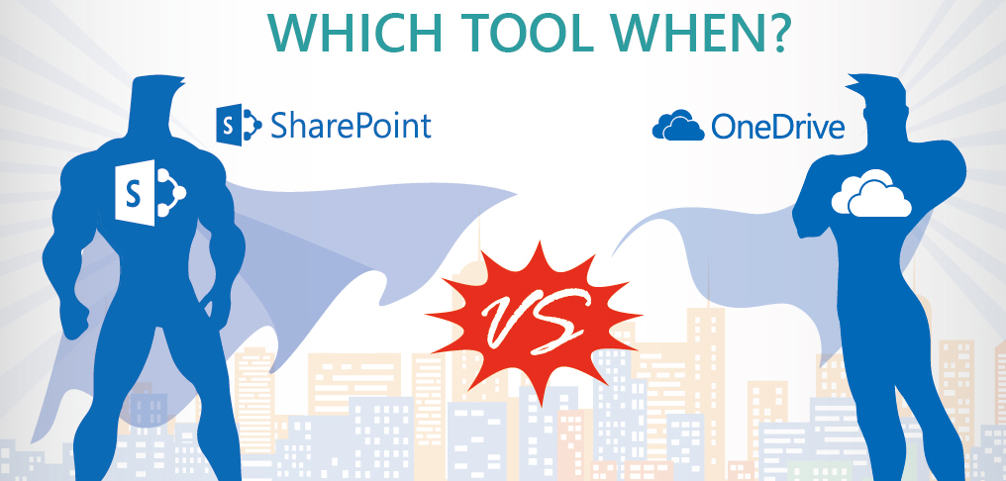
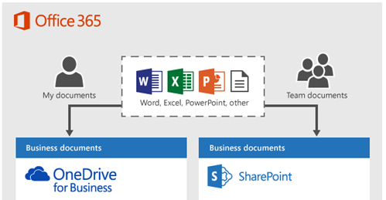
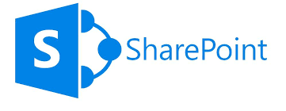
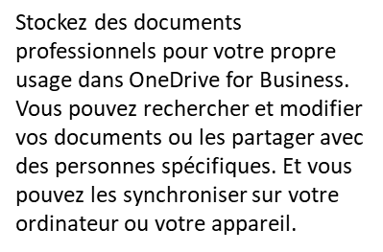
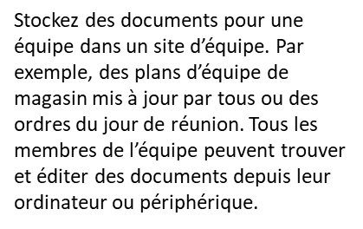
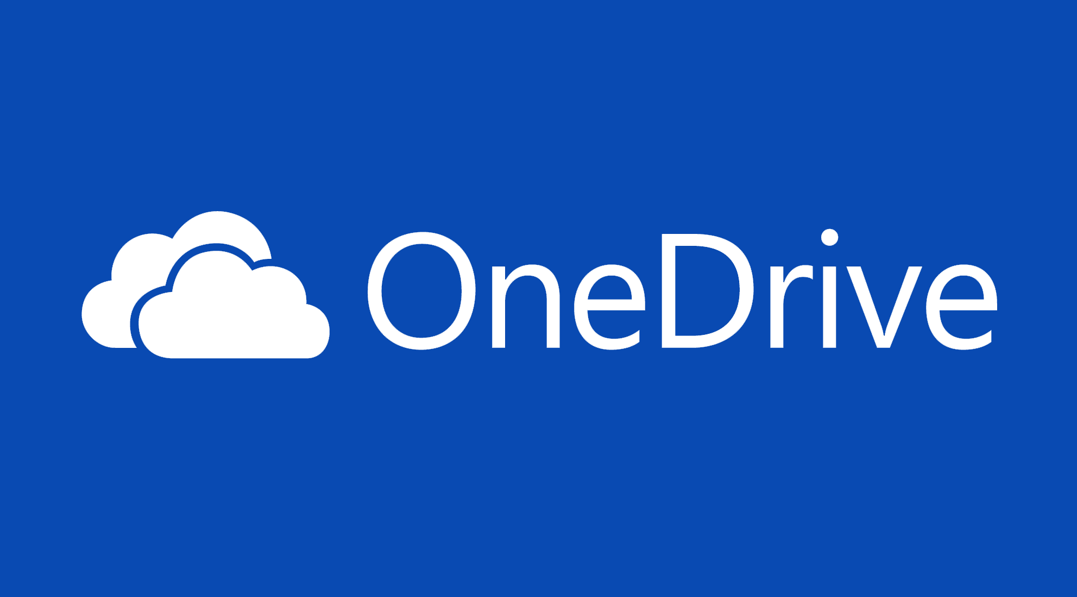
OneDrive Vs SharePoint and Teams Positioning
Online Collaboration Tool
A business portal
Tools: document libraries, calendars, task list...
Teams
Online private document storage platform
Tool: document library
6

Slide 7
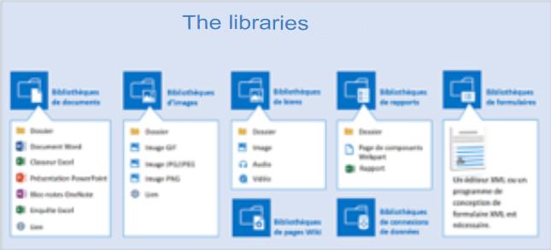
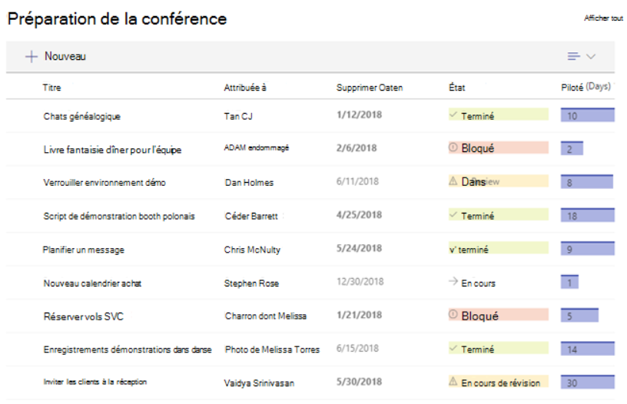
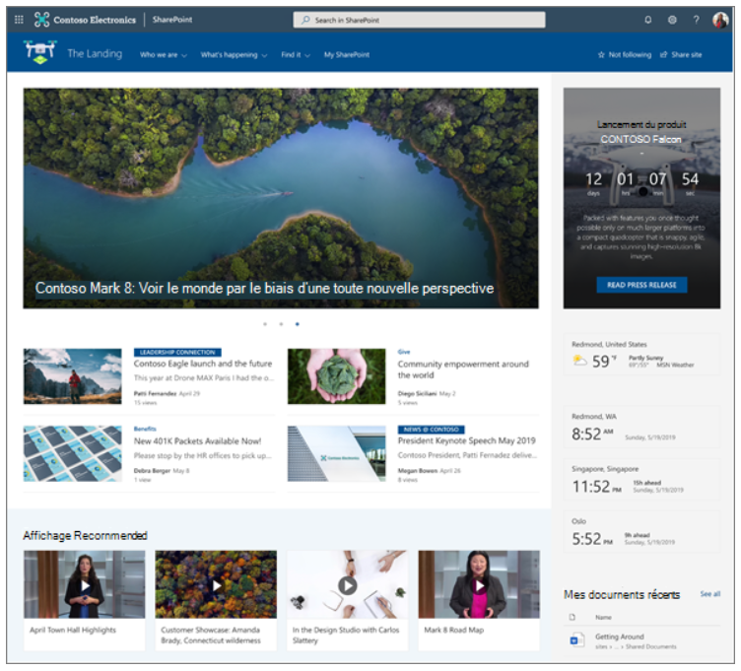
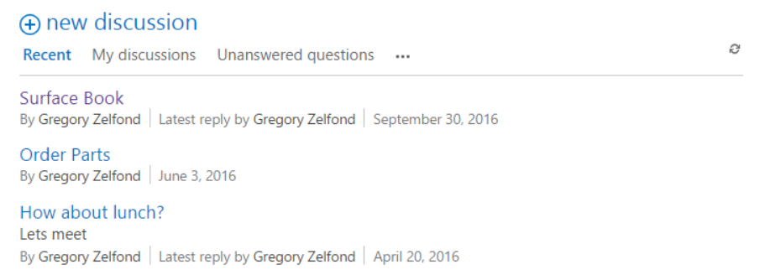
The contents of a SharePoint site
A SharePoint site can contain organized information in the items on the site. Many elements are available and here are the main ones:
Document libraries: true containers of information, there are some variants: image libraries, form libraries.
Libraries can easily replace the file shares that proliferate on servers.
SharePoint lists: Pre-existing or custom, you can think of a SharePoint list as an Excel table - or an Access table - with fields (columns) and records (the list items). SharePoint has many default lists (contacts, calendars, surveys, tasks...).
Web pages
Wiki pages
Discussion Forums
Apps...
Each item can be placed on a page of the site as Web Parts using online editing tools.
7

Slide 8
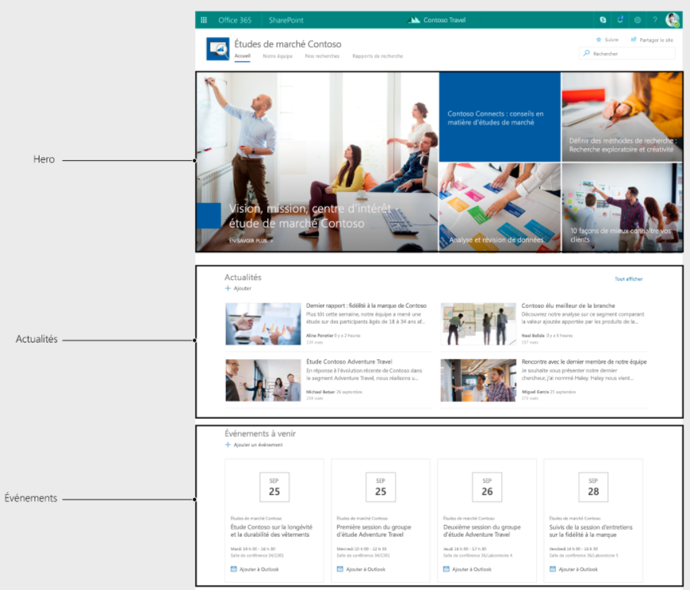
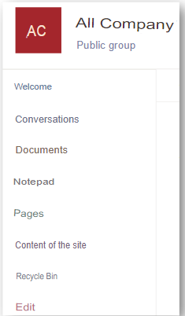
The contents of a SharePoint site
Web Parts
Web Parts are SharePoint items that are placed on a Web page in the portal. A Web Part can display a document library, list, report, video, and so on in its zone.
All items in a site, some of which are available in the Quick Launch bar on the left, can be used as Web Parts. A Web Part has its own display characteristics (dimensions, sorting, filter...) independent of the display of the original item.
The document library
A document library created on the site can be placed on the home page in a Web Part by using the Edit button and page editing mode. In addition, sorting in the default library view may differ from that in the Web Part.
The Quick Launch link bar
The Quick Launch link bar groups all items in the site (libraries, lists, forums, and so on) by object type. We will see that the content and order of the Quick Launch bar are completely customizable. Similarly, you can use certain SharePoint items in Web Parts on a Web page without a link in the Quick Launch. The tabs at the top of the page (or top link bar) are used to distinguish a site from its subsites. When creating portal elements, creating subsites provides a well-siloed view of the information available on the portal.
8

Slide 9
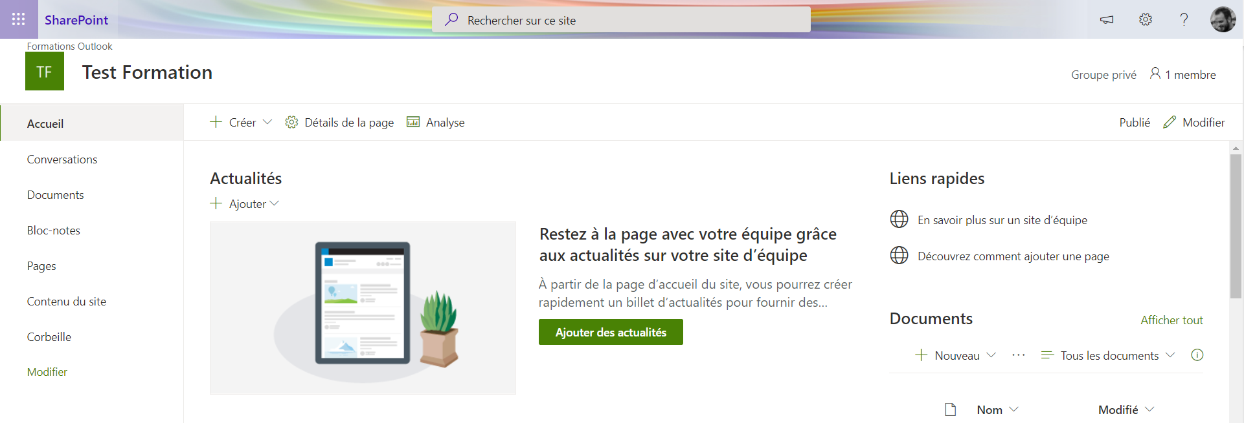
The contents of a SharePoint site
The top link bar
The tabs at the top of the page (or top link bar) are used to distinguish a site from its subsites. When creating portal elements, creating subsites provides a well-siloed view of the information available on the portal.
The Settings button
Finally, note the Settings button at the top right of each portal page, to the left of the user button. This button is most commonly used by administrators. It allows:
Change site permissions (Share With command)
The creation of the elements of the site (subsites, libraries, lists...) via the Add an application command;
Changing the order of the Web Parts to edit mode of the web pages of the portal (changing the order of the Web Parts, adding new Web Parts, removing Web Parts) using the Edit Page command;
Access the Site and Site Collection Administration Settings page through the Site Settings command.
Change the theme of a site using the Change Appearance command.
9

Slide 10
The contents of a SharePoint site
Applications
You can add applications to your SharePoint site, such as libraries, lists, calendars, discussion boards, and more.
By extension, you note that, using the Add Application command of the Settings button, each library, custom list, or already parameterized object is called an application.
The Site Content link also allows you to add an object using the New button and the Add Application command.
10

Slide 11
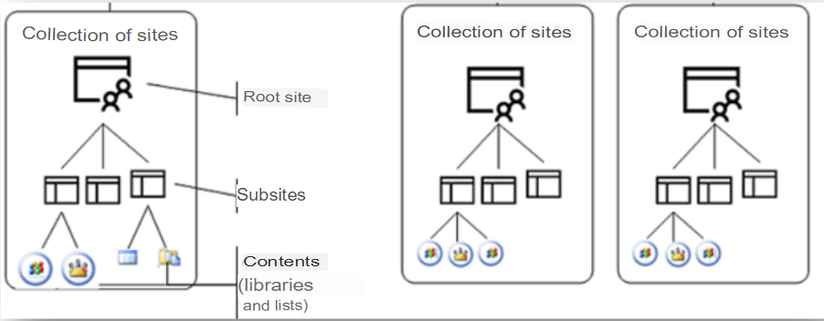
Architecture in SharePoint
Site collections
The site collection represents the content (data) of a SharePoint portal. A site collection contains a root site and subsites from the same path called management paths. The diagram below summarizes this architecture.
Each site collection contains a root site and, if necessary, one or more subsites, always for reasons of classification of the information published and exchanged. Each site contains a set of pages and applications in the SharePoint language that are libraries (of documents, images), lists, or applications available from the SharePoint Store.
Why create multiple site collections?
Examples include:
Organizational reasons: Each department of the enterprise uses information that other departments should not have access to or should be managed by different administrators.
navigation or content types must be siloed.
11

Slide 12
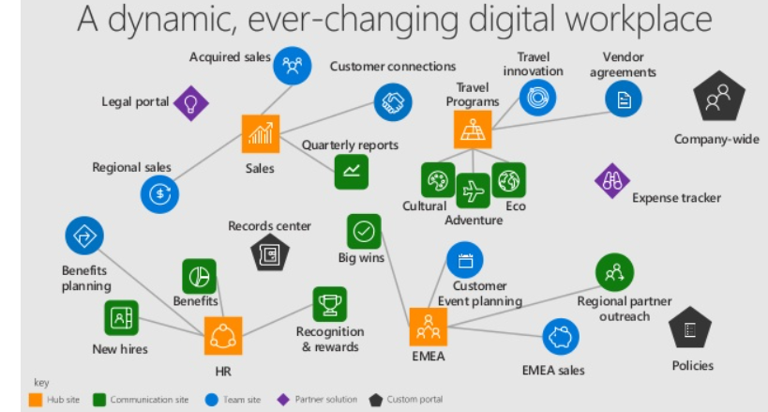
Architecture in SharePoint
The Hubs
SharePoint hub sites help you meet the needs of your organization by connecting and organizing site collections by project, department, region, and so on.
This makes it possible:
discover related content such as news and other site activities
apply common navigation and appearance to all associated sites
search all related sites
Some examples:
It is possible to bring all our project SharePoint sites under a Projects Hub.
It is possible to bring all our department SharePoint sites under a Departments Hub.
For a small business, you can envisage a single Enterprise Hub (acting as the company’s home page) to access the various departments and projects of the company.
Hub benefits:
Common navigation on all Hub sites
Unified search across all Hub sites
Change the appearance of all your sites in 1 click ( toothed wheel)
Check the events and news of all the Hub sites from your homepage
12

Slide 13
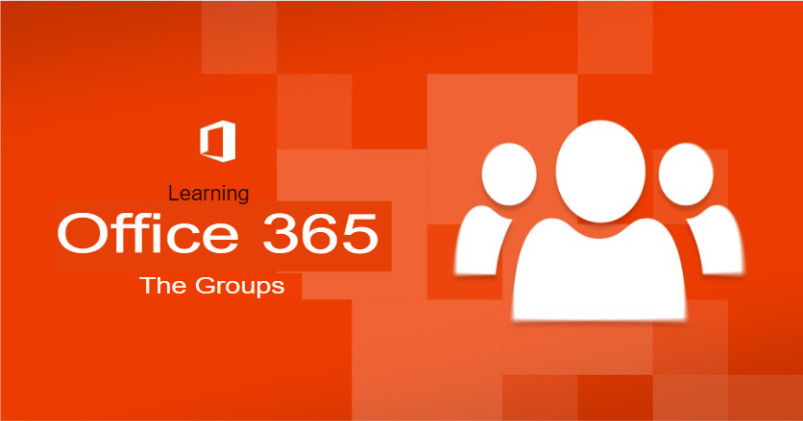
Office 365 groups
Do you know what all SharePoint sites, Teams, and calendars you create have in common?
Is it teamwork? Magic?
But no... these are the Office 365 groups!
Groups are the core service that underpins all of the collaboration functions within Office 365. Office 365 Groups is the hub that lets you manage your resources, set permissions, set rules, govern lifecycles and more!
And the good news is that you only need to create the group once, and then it's applicable to the entire Office 365 suite.

Slide 14
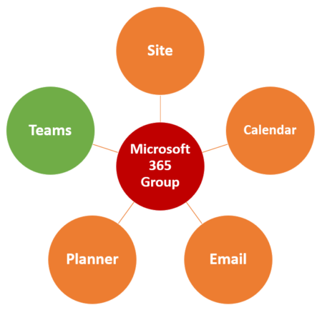
Office 365 groups
Office 365 groups are based on Azure Active Directory (AD).
When you create a SharePoint Teams site or a new schedule in Planner, an Office 365 group is created.
Because Office 365 groups are objects in Azure AD, you can use Azure AD as a central platform to manage, secure, and govern your groups.
Twenty-two Microsoft applications are attached to the Office 365 Groups platform, and they all integrate differently.
Example: When you create a Teams team, you automatically create an Office 365 group. This group is then linked to all the services associated with this team: SharePoint site collection, Outlook calendar, Planner, and OneNote.
This way, all members of this Office 365 group can benefit from these applications and services.

Slide 15
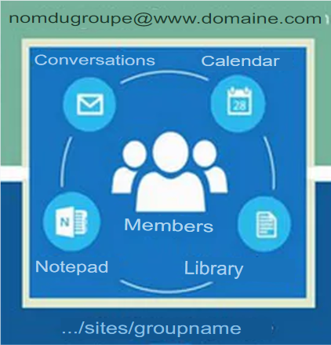
Office 365 Groups
Definition
By creating an Office 365 group, you can create a collaborative environment that consists of a variety of services, including:
an email box
a calendar
a planner plan
a note block
a SharePoint site.
This environment is accessible to owners and members of the group as well as all persons in the organization if the group is public.
​Nb: Office365 Groups have nothing in common with groups used to set access rights in SharePoint Online, nor with email distribution groups.
​As shown below, a Group (with an uppercase G) is made up of members who must collaborate through conversations, meetings, notebooks and/or documents.
15

Slide 16
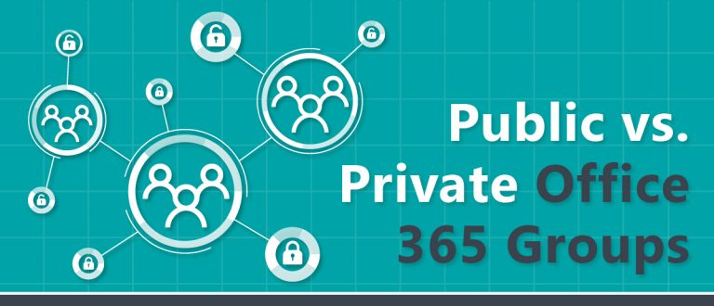
Office 365 Groups
Public Group/ Private Group
The people who created the O365 groups will own these groups (regardless of the method chosen to create the groups).
They will have total control over this group. This will allow them to administer the Teams team associated with this group (if there is a team) and the SharePoint site of the same name.
If the group is public, beware. This means that all company employees can access this group without prior approval. In addition, they will have the right to edit this group, which means they can potentially delete its content. It's not very secure.
For all your groups, except for exceptions, choose a private group. Only invited people will be able to see the content and as a member they will not be able to administer the group ( delete content...)
You can invite someone to become a member (or owner) of an O365 group from your Teams team or SharePoint site.
Remember, you give it access to all the services in the Office365 group ( SharePoint site, library, calendar...)
16

Slide 17
Office 365 Groups
Link to Teams and SharePoint
We saw earlier that creating an Office 365 group automatically creates a SharePoint site with the same name.
When you create a team in Teams, you can choose to:
create a team from an existing Office365 group
or from scratch
If you choose From scratch, it will also automatically create an Office 365 group ( and therefore a SharePoint site with the same name).
Finally, if you create a SharePoint team site, it will also create an Office365 group with the same name (only communication sites do not have an Office365 group attached).
For your information, there are 20 ways to create an Office365 group described in the link below
(https://sharepointmaven.com/20-ways-to-create-an-office-365-group/ )
Tips: If creating Teams is self-service for employees to create teams for their project, you might want to create a Projects Hub to link all SharePoint sites that are automatically created when employees create Teams.
Conclusion: Office365 groups are at the heart of the collaboration. Whether you use Teams, SharePoint, or both, there's always an Office365 group behind your Teams team or SharePoint site.
17

Slide 18
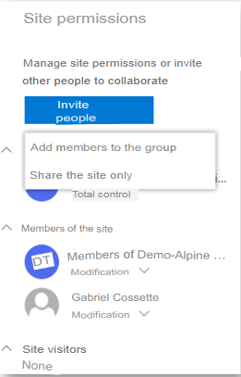
Office 365 Groups
Let's take an example:
Are you inviting a colleague to collaborate on your Teams team? You invited this colleague from Teams?
Your colleague will be added automatically as a member of this group.
As such, in addition to having access to your Teams team, they will also have access to your SharePoint site.
Share site only ( recommended for external users):
If you want, you can share access to a SharePoint site without sharing access to the associated group (and thus team access in Teams)
On your SharePoint site, in Site Permissions, when you click Invite People, choose Share Site Only instead of Add Members to Group.
18

Slide 19
Office 365 Groups
Sharing access to a SharePoint site only is of great interest depending on your internal organization.
Here are the 2 most common examples:
We want to share targeted content with an outsider.
We don't want to invite him to our Teams team because we don't want him to be able to see the content of each public channel (a team potentially contains several channels, there could be for each one the conversation thread, the library...).
Unfortunately, at the moment it is not possible to grant access only to a private channel of our team (Microsoft is working on it).
On SharePoint, you can create unique permissions (through SharePoint groups) and thus manage access to each of the items on my site.
Example: For example, you might have an SP site that contains 2 libraries, 1 calendar, and 2 custom lists. External access (read-only or edited) can only be granted to 1 library and the calendar, for example.
SharePoint provides better bursting and permission management than Microsoft Teams
19

Slide 20
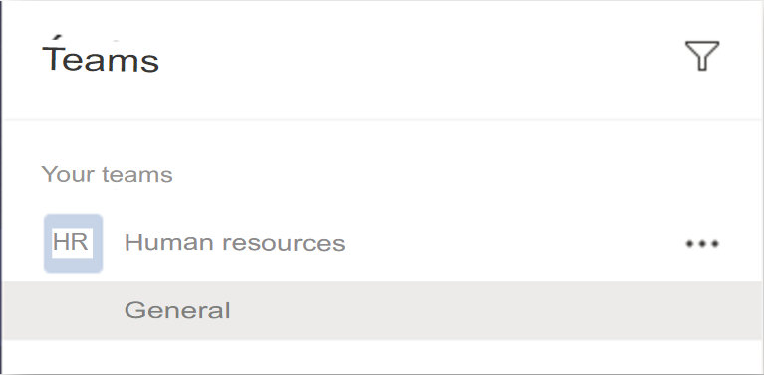
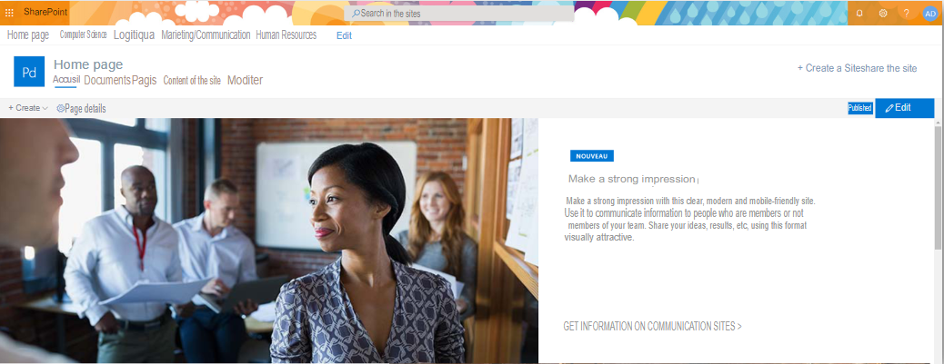
Office 365 Groups
2.Our company uses Teams to collaborate by department.
Our teams are private so in Teams we only see our department.
It might be a good idea to add read-only access to SharePoint sites in other departments.
This allows employees to stay informed of the activity in all departments of the company.
In Teams, I only see my department
In SharePoint, I can view sites in other departments as read-only
20

Slide 21
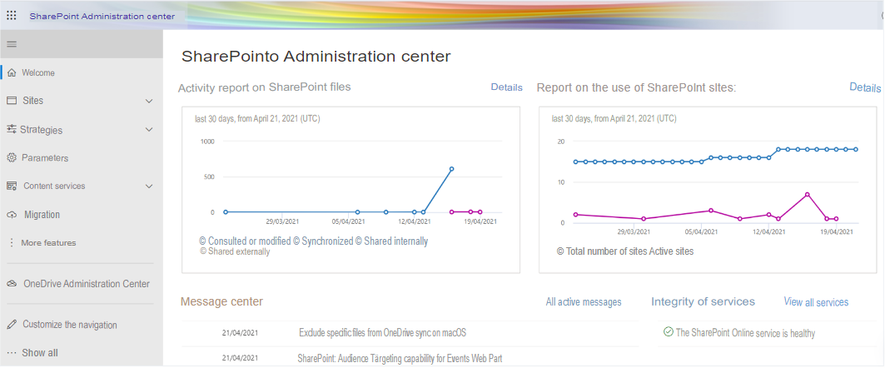
The SharePoint Online Administration Portal
The SharePoint admin center will allow you to administer your SharePoint.
PowerShell can also be used. PowerShell is a powerful environment for running or scripting administrative tasks using a common syntax for all Microsoft products.
The SharePoint Online instance is already configured when the Office 365 account is created. As such, administrators are not responsible for managing web applications or content databases, as these levels are not accessible to clients.
21

Slide 22
The SharePoint Online Administration Portal
Sites
The first site collection is automatically created at the root of the external address of the instance which is a subdomain of the domain "sharepoint.com" with the company name as a prefix. A root site based on the team site template is automatically provisioned. The root site is virtually devoid of any content other than a document library. Finally, all of the service applications available in SharePoint Online have been provisioned, and the administrator must configure them.
A second site collection named All Company is also created by default under the team site template. It is a public group, so this collection is accessible without any permissions required by company members.
22

Slide 23
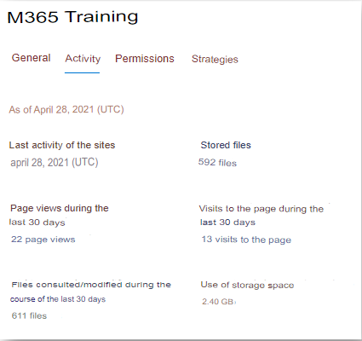
The SharePoint Online Administration Portal
Sites
The Sites tab allows you to:
Create a new site collection
Edit or delete an existing site collection
Set a site collection as a Hub or assign a site collection to an existing Hub
Set sharing permissions for a specific site collection
Manage site collection owners
Identify the most popular, largest sites...
Bulk edit multiple site collections
View site activity
Create
Permissions
Share
Delete
23

Slide 24
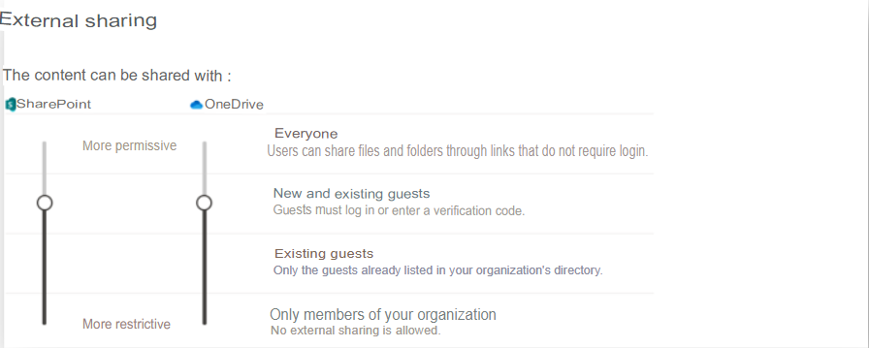
The SharePoint Online Administration Portal
Policies
Sharing: It allows you to define with whom the SP content can be shared, what type of link and what permission will be selected by default for sharing links ( read-only or edit right)
.
For example, you can limit sharing for members of your organization or allow sharing with everyone. Note that this setting is linked to OneDrive. The two applications must have the same permission level.
Later, we'll see that you can change this setting for a specific site collection.
24

Slide 25
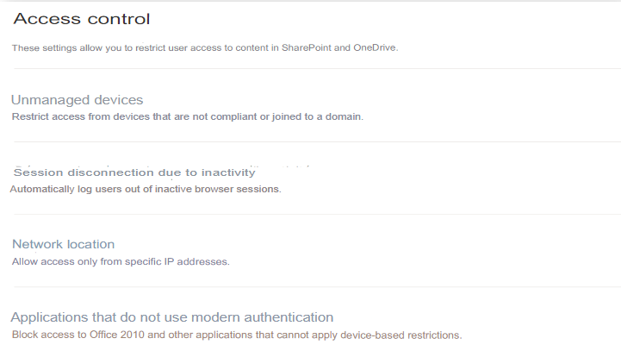
The SharePoint Online Administration Portal
Policies
Access Control: SharePoint can be restricted to certain machines or prohibited for devices not joined to an Active Directory or Azure AD domain ( if you have an Enterprise Mobility+ Security subscription). The settings on the Access Control page also allow you to restrict access based on the authentication mode supported by client software or limit access to certain ranges of IP addresses.
.
25

Slide 26
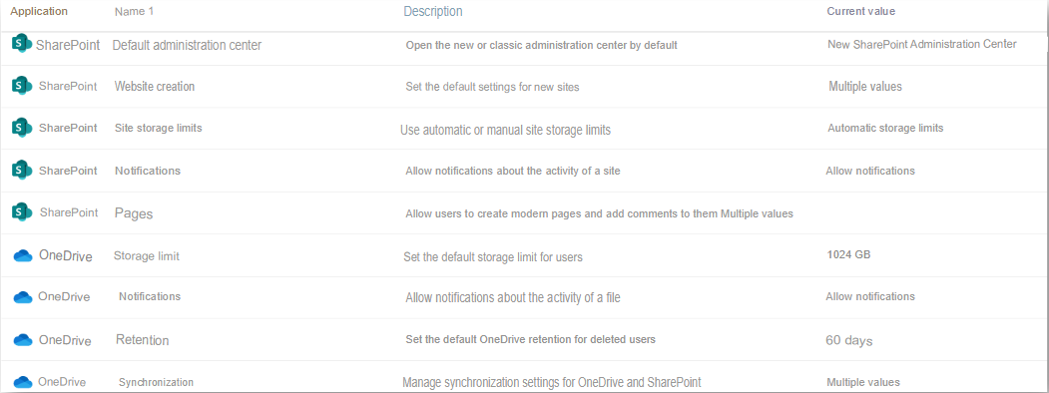
The SharePoint Online Administration Portal
Parameters
A set of choices concerning the interfaces and functionalities are to be set in the Parameters page:
Do you want to use the new SharePoint Admin Center (recommended) or classic version of the Admin Center?
Do you allow users to create sites from the SharePoint and OneDrive home page?
Control the storage limit of your site collections
Enable SharePoint notifications on the mobile app
Whether to allow users to create modern pages and whether to add comments to modern pages
Manage file sync in SharePoint and OneDrive
.
26

Slide 27
The SharePoint Online Administration Portal
Content Services
Term Store:
A managed metadata column is a new type of column that can be added to lists, libraries, or content types to allow site users to select the values of a specific set of managed terms and apply those values to their content.
This controls what information users can enter in a column. Users select the terms or expressions they enter in the column from a predefined set of managed terms.
You can create a new specific term set for a column of metadata managed through the term store.
You can then apply your metadata to your lists, libraries, and applications that support them.
.
27

Slide 28
The SharePoint Online Administration Portal
Content Services
Content Type Gallery:
A content type gathers an item and information about it. The item can be one of several file types, an Excel document, or even a status indicator for a progress report. It can also be a list or a folder. A content type associates this item with key metadata or other information such as a retention policy or template.
For example, you can define a Sales Agreement content type and add it to the library your team uses. Then, each time someone wants to create a sales proposal, they simply choose Sales Agreement from the New Document menu.
A document content type such as this sales agreement can have the following attributes:
Template for document
Columns associated with content, where each column represents a metadata element. For example, the following list shows commonly used document metadata:
Seller
Customer Company
Purchase order number and so on...
Requires that the Document Information Panel be automatically displayed and that the required information be collected each time a user creates a document information file
.
28

Slide 29
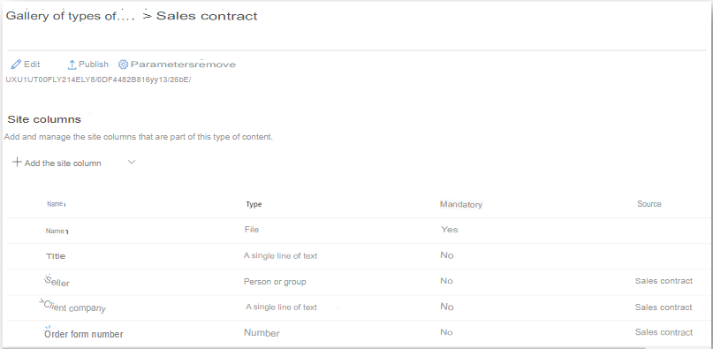
The SharePoint Online Administration Portal
Content Services
Content Type Gallery:
Content types are defined for a site and apply to that site and its subsites. But you can use a particular content type on multiple sites or on multiple site collections.
For example, your organization might use a standard template for documents that require standardized metadata. Because you want everyone in your organization to use this type of content for documents, it is a good idea to publish to all site collections.
Because content types include metadata, content types and metadata are very closely related. A managed metadata service in SharePoint allows you to publish a content type to the sites where it is used. Sites and site collections that are part of the managed metadata service are called subscribed sites
.
29

Slide 30
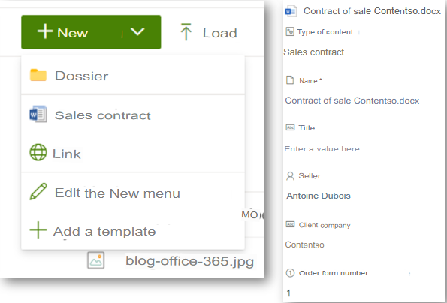
The SharePoint Online Administration Portal
Content Services
Content Type Gallery:
Content types can be set for almost any SharePoint item. This includes documents and other files, list items, media files, and folders.
You can specify the following attributes for each content type. These attributes are automatically associated each time a person creates a document or other file of a particular content type:
Document template if it is a document
Information Management Policies
Retention and Audit Policies
Content related metadata
Workflows that items of this content type can use
Custom Features
.
30

