Slide 1

The Fundamentals of Power BI
Exploring Power BI for effective data insights
Notes:
---
Welcome to the presentation on Power BI, a powerful tool for data analysis and visualization. Today, we will explore its capabilities, from data importing to advanced features, enabling you to harness the full potential of this software.

Slide 2

Agenda for Power BI Fundamentals
Introduction to Power BI
Data Importing in Power BI
Understanding DAX Metrics
Operating the Power BI Website
Advanced Features and Best Practices
Notes:
This presentation will cover the fundamentals of Power BI. We will start with an introduction to Power BI, followed by data importing techniques, understanding DAX metrics, operating the Power BI website, and advanced features, including best practices. By the end, you will have a comprehensive understanding of Power BI.

Slide 3

Introduction to Power BI
Notes:
Power BI is a business analytics tool by Microsoft that helps visualize data and share insights across an organization. It enables users to create interactive reports and dashboards.

Slide 4
Overview of Power BI
Power BI Desktop
Power BI Desktop is a powerful tool for designing reports with advanced data visualization features.
Power BI Service
Power BI Service allows users to share insights and collaborate on reports in the cloud seamlessly.
Power BI Mobile
Power BI Mobile provides access to reports and dashboards on-the-go, ensuring insights are available anytime and anywhere.
Notes:
Power BI consists of several components, including Power BI Desktop, Power BI Service, and Power BI Mobile. Each component serves a unique purpose, from designing reports to sharing insights on-the-go.

Slide 5

Key Features and Capabilities
Data Connectivity
  Power BI allows seamless data connectivity from various sources, enabling comprehensive data analysis.
Real-Time Analytics
  With real-time analytics, Power BI provides up-to-the-minute insights that support timely decision-making.
Interactive Dashboards
  Power BI features interactive dashboards that allow users to explore data visually and intuitively.
Data Modeling
  The data modeling capabilities of Power BI enable users to create complex data structures for detailed analysis.
Notes:
Power BI offers various features such as data connectivity, real-time analytics, interactive dashboards, and data modeling. These capabilities make it a versatile tool for data-driven decision-making.

Slide 6

Benefits of Using Power BI
User-Friendly Interface
  Power BI features an intuitive interface that allows users to navigate easily and create reports quickly.
Powerful Data Visualization
  The platform offers robust data visualization tools that help users present data insights effectively through various charts and graphics.
Integration with Microsoft Products
  Power BI easily integrates with other Microsoft products, enhancing productivity and collaboration across different tools.
Empowering Non-Technical Users
  Power BI empowers users to derive valuable insights without requiring deep technical skills, making data accessible to everyone.
Notes:
The benefits of using Power BI include its user-friendly interface, powerful data visualization tools, and integration with other Microsoft products. It empowers users to derive insights without extensive technical expertise.

Slide 7
Data Importing in Power BI
Notes:
Importing data is a crucial step in the Power BI process. This section will discuss how to connect to various data sources and ensure data is prepared correctly for analysis.

Slide 8

Connecting to Data Sources
Diverse Data Connections
  Power BI provides support for connecting to a wide range of data sources, enhancing analysis capabilities.
User-Friendly Data Import
  Users can easily import data from multiple sources, facilitating quick data analysis and decision-making.
Supported Data Formats
  Power BI supports a variety of data formats, including Excel files, CSV, and data from databases, ensuring flexibility.
Notes:
Power BI supports connections to various data sources, including Excel files, databases, cloud services, and online data sources. Users can easily import data from these sources to start their analysis.

Slide 9

Data Transformation and Cleaning
Importance of Data Cleaning
  Data cleaning is essential for accurate analysis, ensuring that the data is reliable and free from errors.
Power Query Tools
  Power BI's Power Query offers a set of powerful tools to help users transform and clean their data effectively.
Efficient Data Preparation
  Efficiently preparing data for analysis allows users to gain insights faster and make informed decisions.
Notes:
Once data is imported, it often requires transformation and cleaning. Power BI provides tools like Power Query to help users manipulate and prepare their data for analysis efficiently.

Slide 10

Best Practices for Data Importing
Data Integrity
  Maintaining data integrity is crucial for accurate and reliable data analysis. Implementing best practices during import helps achieve this goal.
Optimizing Data Models
  Optimizing data models ensures efficient data processing and retrieval. It's essential for enhancing overall system performance.
Documenting Data Sources
  Documenting data sources aids in tracking and understanding the origin of data. This practice supports transparency and accountability.
Validating Imported Data
  Validating imported data ensures accuracy and consistency. This step is critical to avoid discrepancies in analysis.
Notes:
Adhering to best practices when importing data helps maintain data integrity and performance. This includes optimizing data models, documenting data sources, and validating imported data.

Slide 11
Understanding DAX Metrics
Notes:
Data Analysis Expressions (DAX) is a formula language used in Power BI for data modeling. This section will introduce DAX and its importance in creating insightful metrics.

Slide 12

Introduction to DAX (Data Analysis Expressions)
Custom Calculations
  DAX enables the creation of custom calculations tailored for specific analytical needs within Power BI reports.
Enhancing Data Analysis
  Mastering DAX is essential for building complex formulas that improve the depth and insight of data analysis.
Notes:
DAX allows users to create custom calculations in Power BI reports. Understanding DAX is essential for creating complex formulas that can enhance data analysis.

Slide 13
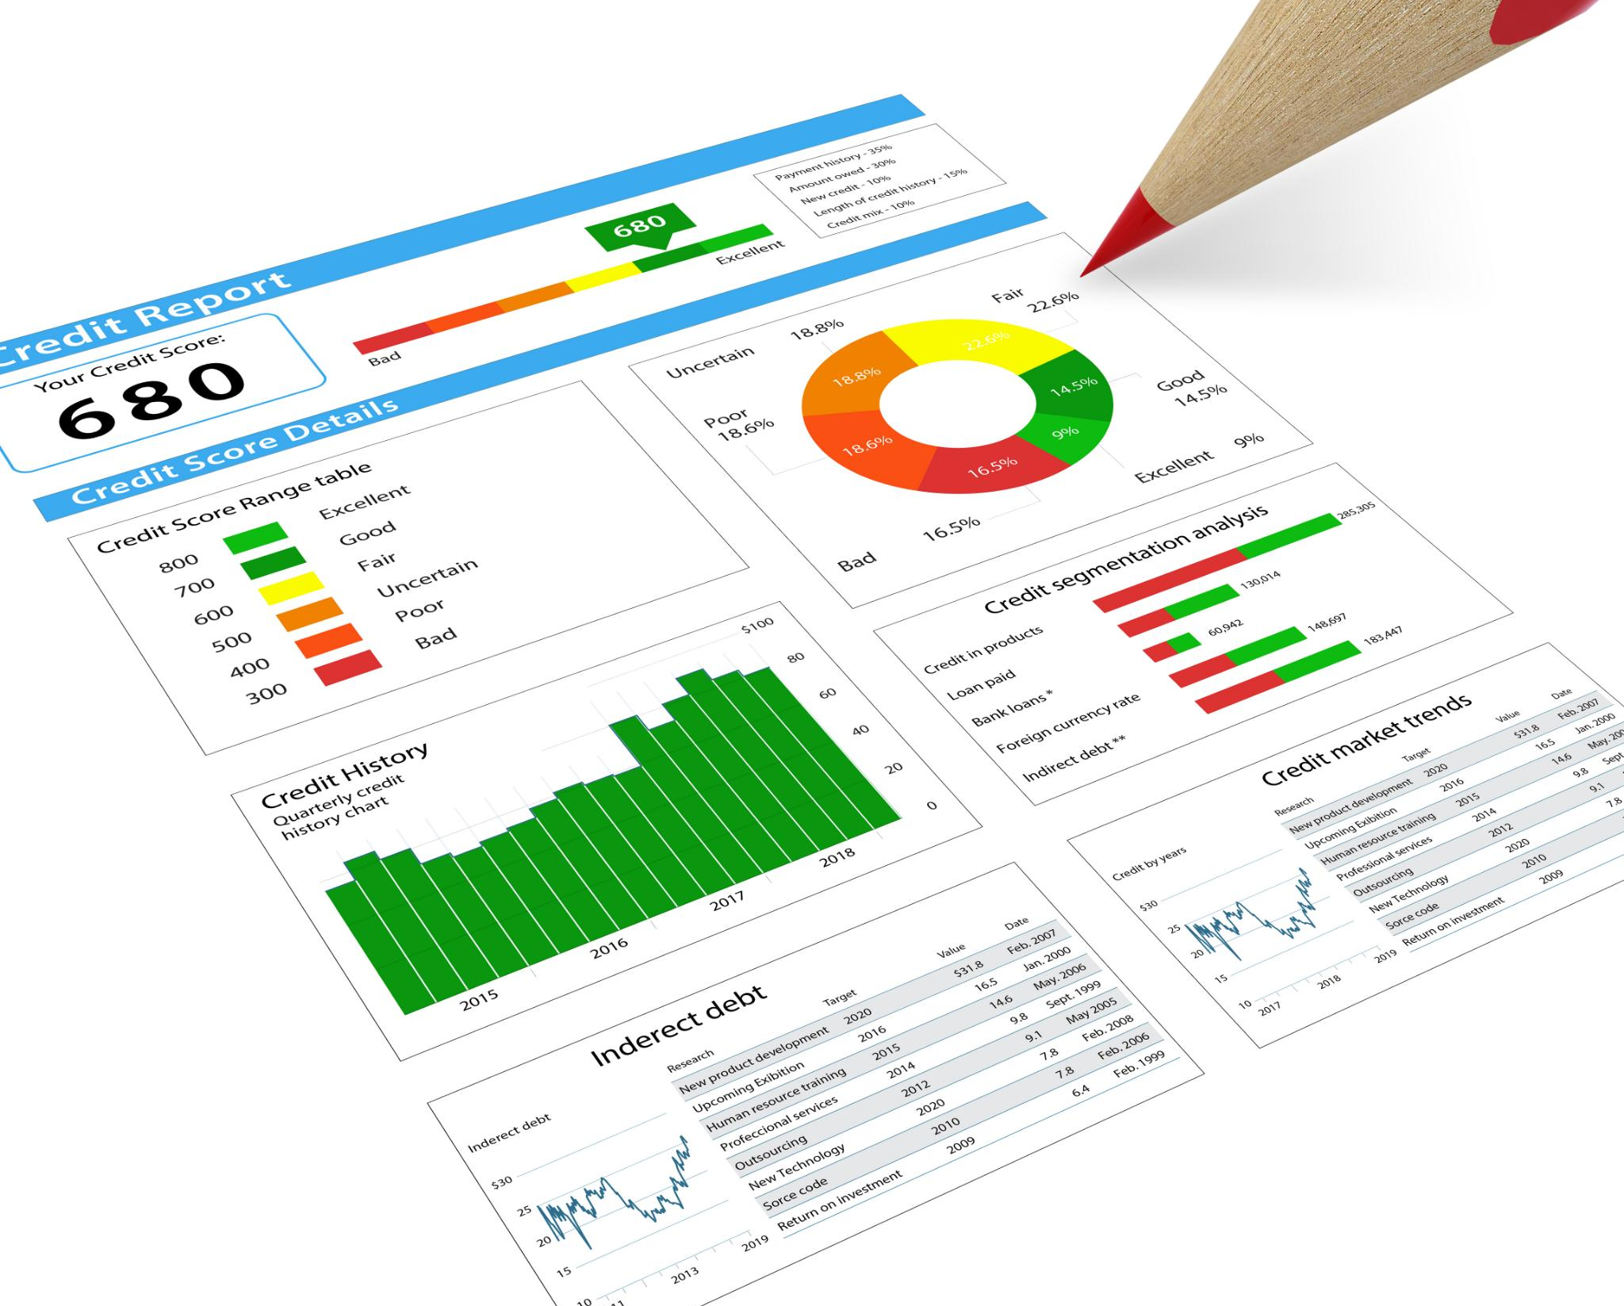
Creating Calculated Columns and Measures
Role of Calculated Columns
  Calculated columns are essential for enhancing data tables, allowing for better data organization and analysis.
Dynamic Measures
  Measures enable dynamic calculations in reports and dashboards, providing real-time insights and analytics.
Notes:
Calculated columns and measures are key components in Power BI. Calculated columns enhance data tables, while measures allow for dynamic calculations in reports and dashboards.

Slide 14

Common DAX Functions and Examples
Understanding SUM Function
  The SUM function is used to add up values in a column, essential for aggregating data in reports.
Using AVERAGE Function
  The AVERAGE function calculates the mean of a set of numbers, providing insights into central tendencies in data.
COUNTROWS Function Explained
  COUNTROWS function counts the number of rows in a table, useful for tracking records and data entries.
Notes:
Familiarity with common DAX functions such as SUM, AVERAGE, and COUNTROWS is vital for effective reporting. We will explore examples of these functions in practical scenarios.

Slide 15
Operating the Power BI Website
Notes:
Navigating the Power BI website is essential for utilizing its features. This section will cover how to share reports, collaborate with team members, and manage dashboards efficiently.

Slide 16

Navigating the Power BI Service
Online Access
  The Power BI Service enables users to access reports and dashboards from any device with an internet connection.
User Interface
  Familiarity with the Power BI interface is crucial for effective navigation and utilization of its features.
Functionalities Overview
  Understanding the functionalities of Power BI enhances user efficiency in managing data and generating insights.
Notes:
The Power BI Service is an online platform that allows users to access reports and dashboards from anywhere. Understanding its interface and functionalities is key to effective usage.

Slide 17

Sharing and Collaborating on Reports
Efficient Report Sharing
  Power BI streamlines the process of sharing reports with colleagues and stakeholders, enhancing accessibility and collaboration.
Enhanced Collaboration Features
  Collaboration features in Power BI enable teams to work together more effectively, improving overall project outcomes and decision-making.
Notes:
Power BI enables users to share reports with colleagues and stakeholders efficiently. Collaboration features facilitate teamwork and enhance decision-making processes.

Slide 18

Publishing and Managing Dashboards
Effective Insights Presentation
  Publishing dashboards enables users to share valuable insights in a clear and impactful manner, facilitating informed decision-making.
Content Management
  Managing dashboards includes updating content to ensure the information remains relevant and useful for the users.
Setting Permissions
  Setting permissions is essential for managing user access and ensuring the right stakeholders have access to the necessary information.
Notes:
Publishing dashboards allows users to present insights effectively. Managing dashboards involves updating content, setting permissions, and ensuring relevant information is available to users.

Slide 19
Advanced Features and Best Practices
Notes:
This section will explore the advanced functionalities of Power BI that enhance user experience and improve data analysis outcomes.

Slide 20
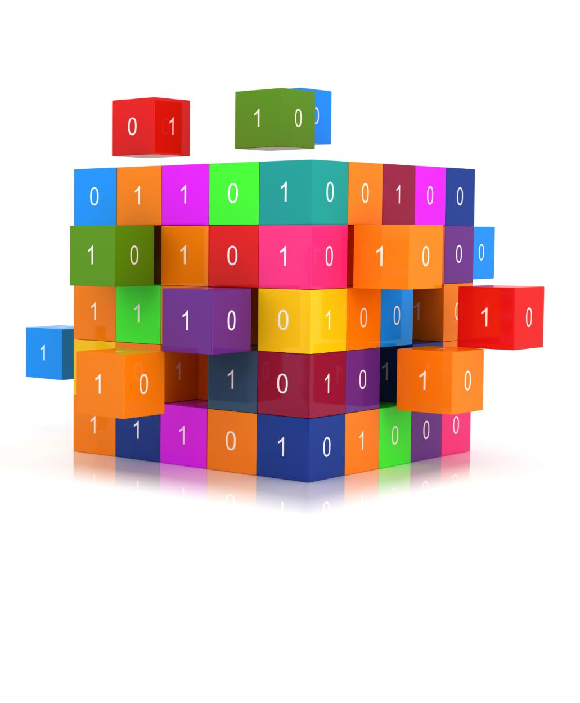
Using Power Query for Data Manipulation
Data Reshaping
  Power Query enables users to reshape data efficiently, making it suitable for analysis and reporting.
Data Transformation
  Power Query allows users to transform data through various processes, enhancing data usability for reporting.
Data Cleaning
  Power Query facilitates data cleaning, ensuring high-quality data is available for accurate reporting and analysis.
Notes:
Power Query is a powerful tool for data manipulation in Power BI. It allows users to reshape, transform, and clean data before analysis, improving reporting efficiency.

Slide 21

Creating Interactive Visualizations
Diverse Visualization Options
  Power BI provides an array of visualization options such as charts, maps, and tables to represent data.
Understanding Data Trends
  Interactive visualizations allow users to comprehend data trends and gain valuable insights more effectively.
Notes:
Power BI offers various visualization options, including charts, maps, and tables. Creating interactive visualizations helps users understand data trends and insights more effectively.

Slide 22

Optimizing Performance and Data Models
Data Reduction Techniques
  Implementing data reduction techniques helps streamline data models, reducing the size and improving performance in Power BI.
Query Optimization
  Optimizing queries is essential for enhancing performance, allowing faster data retrieval and better user experience in Power BI.
Model Relationships
  Establishing effective model relationships improves data navigation and usability, enabling users to derive insights more efficiently.
Notes:
Creating efficient data models is crucial for optimal performance in Power BI. Users should focus on data reduction techniques, query optimization, and model relationships to enhance speed and usability.

Slide 23
Conclusion
Power BI Overview
Power BI is a robust data analysis tool that empowers organizations to visualize data effectively and make informed decisions.
Enhancing Decision-Making
The tool plays a vital role in enhancing decision-making processes by providing clear insights derived from data.
Leveraging Potential
Understanding Power BI's fundamentals allows users to leverage its full potential for improved business outcomes.
Notes:
In conclusion, Power BI is a powerful tool for data analysis and visualization that can significantly enhance decision-making processes in organizations. By understanding its fundamentals, users can leverage its full potential to drive insights and improve business outcomes.

